Slide 1
Keyrtual
A Lightweight Mixed Reality Musical Keyboard For Smartphone
Andrea Princic
Advisor: Prof. Luigi Cinque
Notes:
Good morning, everyone. Today I’m going to talk about Keyrtual: a lightweight mixed reality musical keyboard for smartphone

Slide 2



Keyrtual
Notes:
First, I’d like to thank Fondazione TIM and Fondazione Catalano for believing in this project and for the financial support

Slide 3
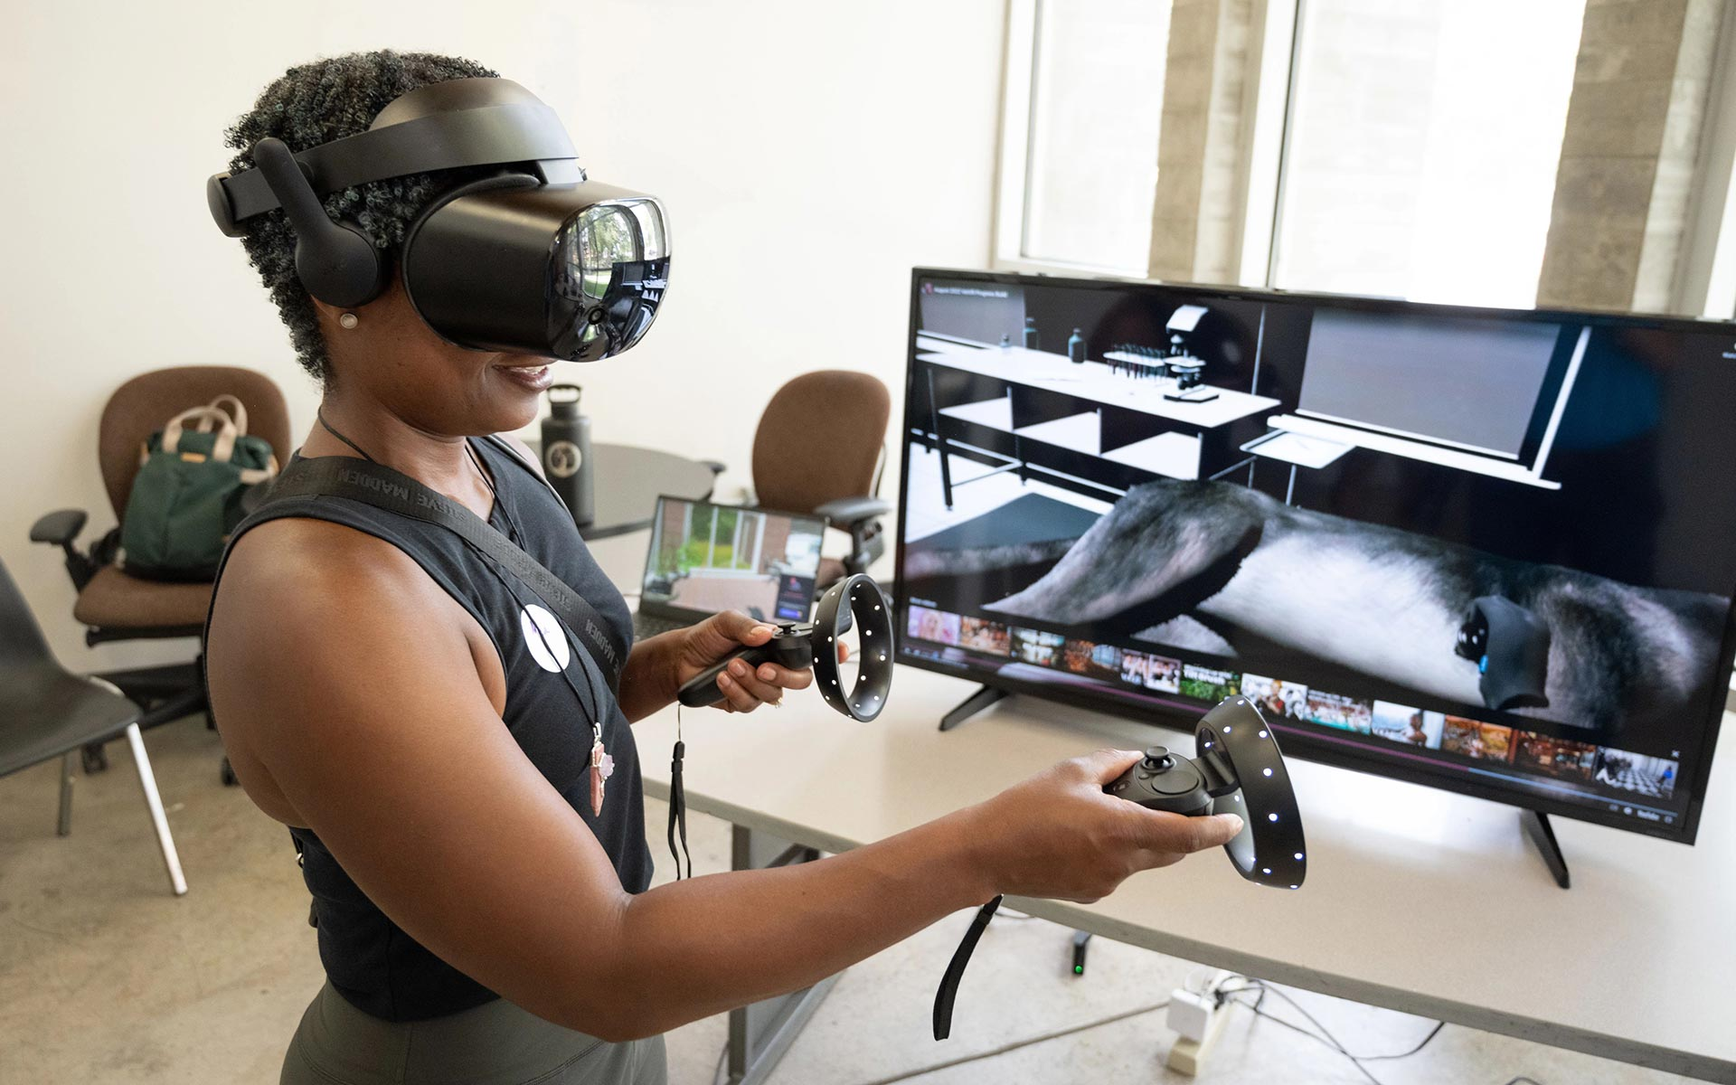
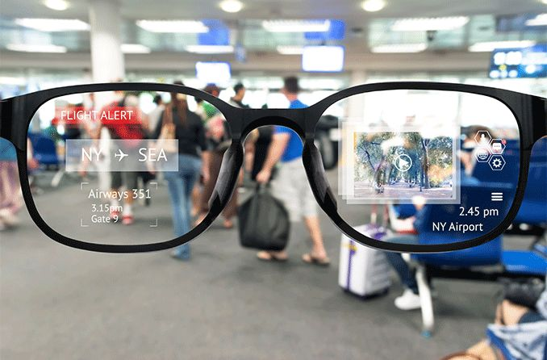
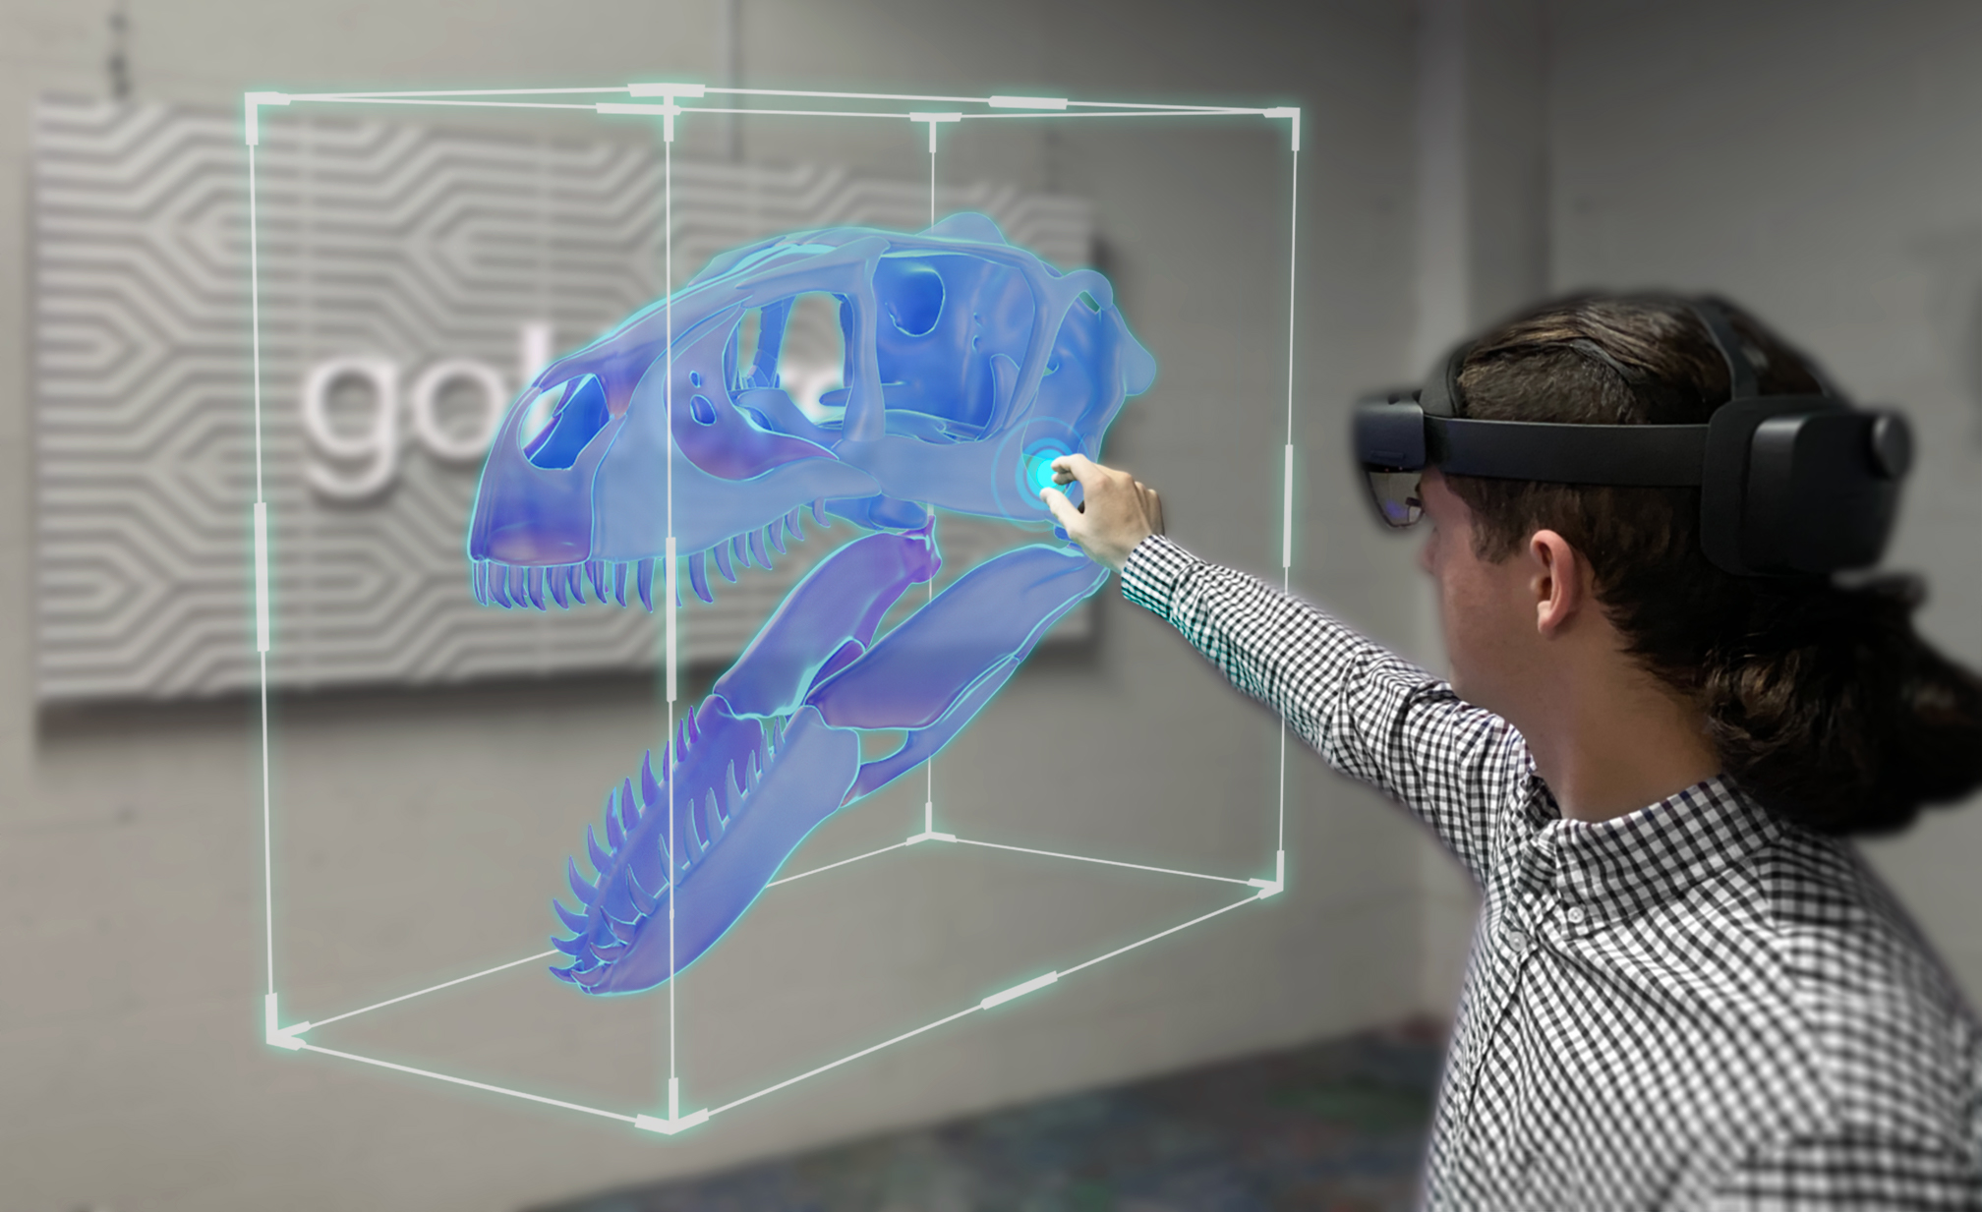
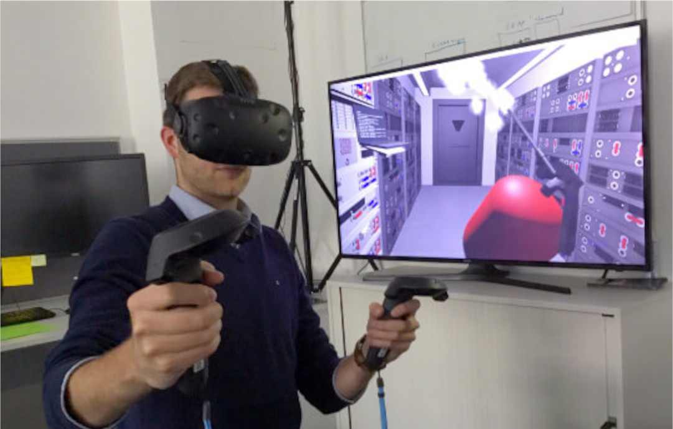
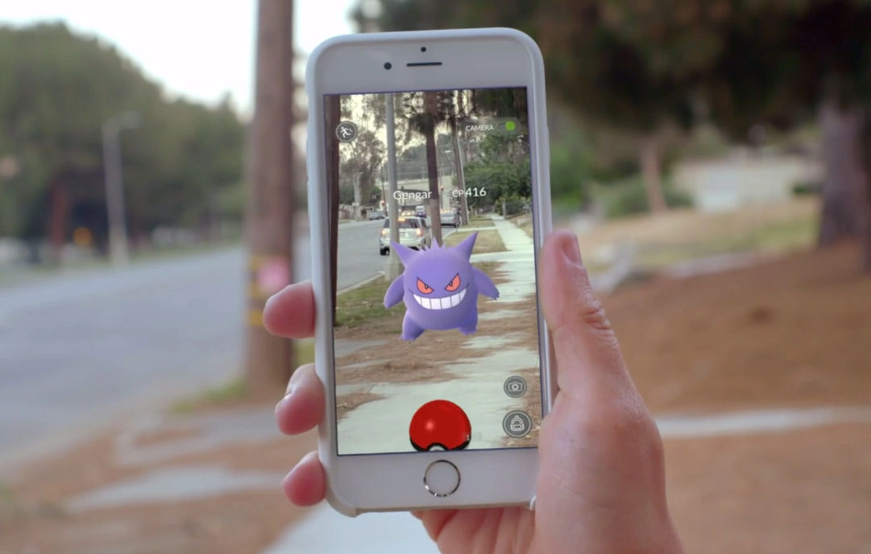
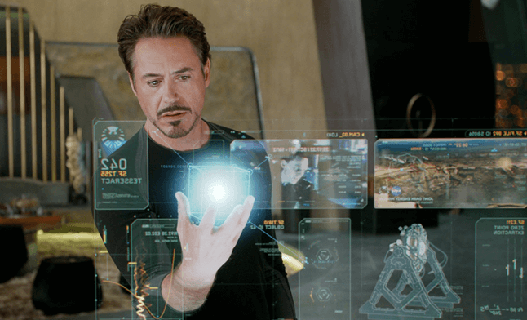
The new Reality
Virtual Reality
Augmented Reality
Mixed Reality
Notes:
What is mixed reality and why is it different?
VR is when you put a headset on and you enter a completely virtual world, like a videogame or a simulation
AR is when virtual elements are somehow visible in the physical world, but you can only interact with them using a dedicated interface
Finally, MR is when virtual and physical elements exist in the same world and can interact with each other

Slide 4
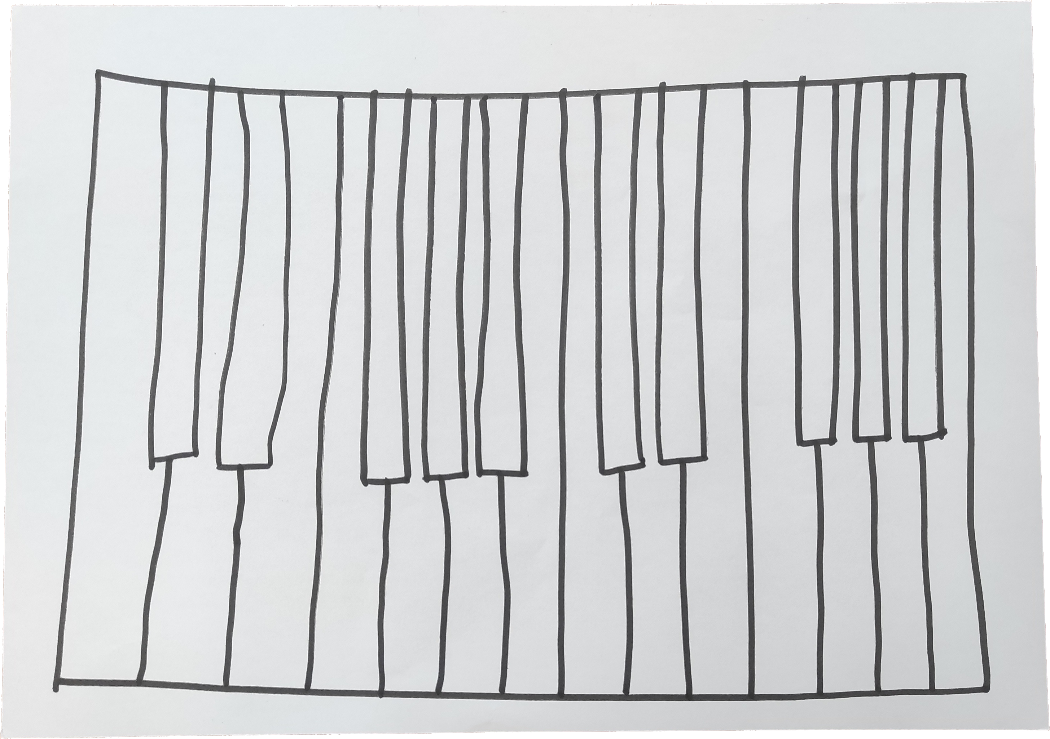
The goal
Hand-drawn keyboard, real notes
Education
Cheap
Lightweight
Notes:
The goal is to create a mixed reality application to play a keyboard on a piece of paper, to be used especially in the context of education which could cut the initial cost of having to buy an instrument.
We want it to be as compatible and lightweight as possible, so that everyone can use it

Slide 5
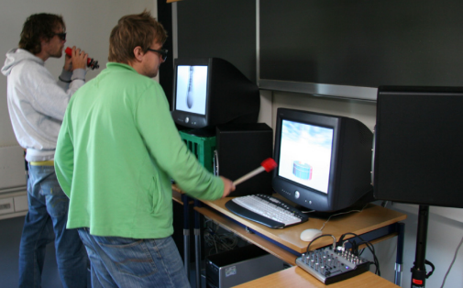
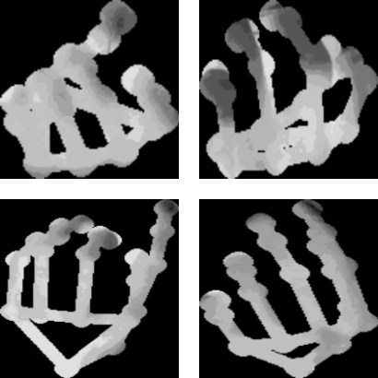
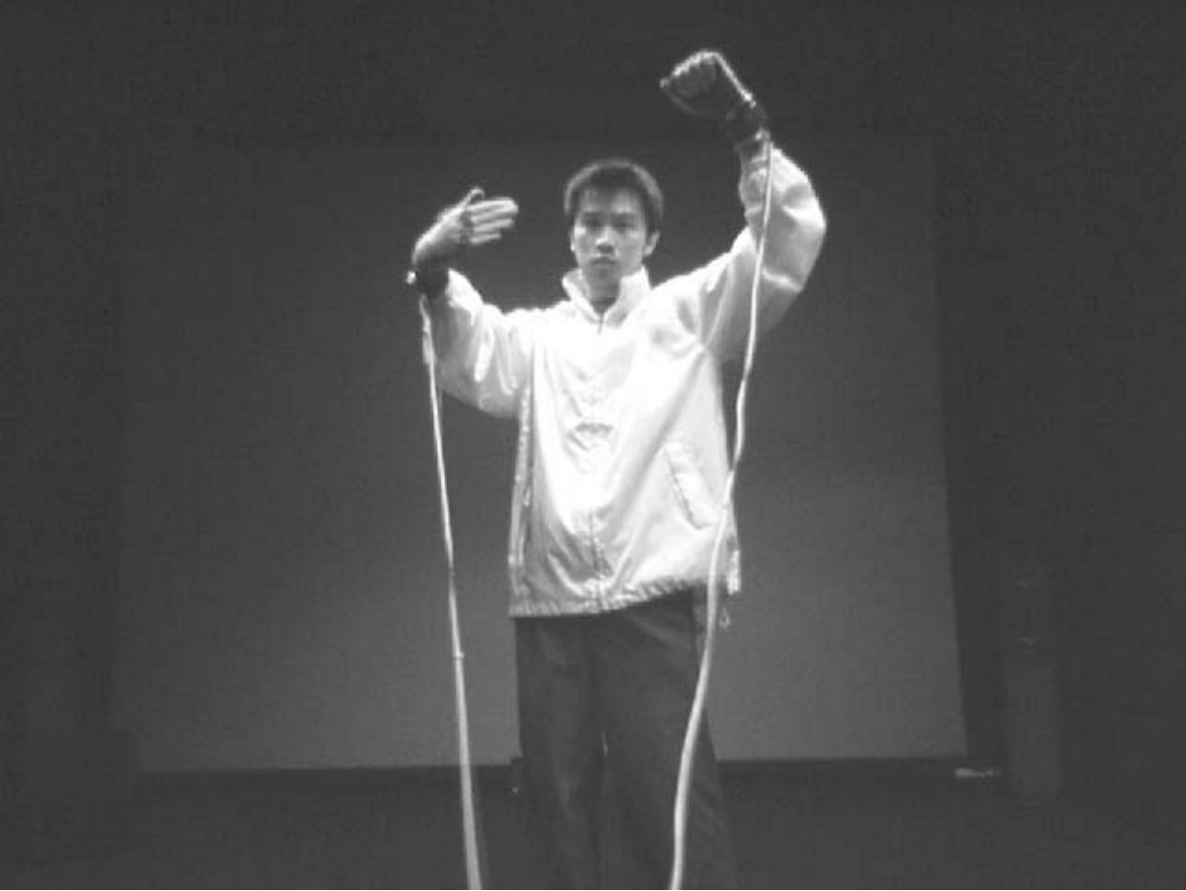
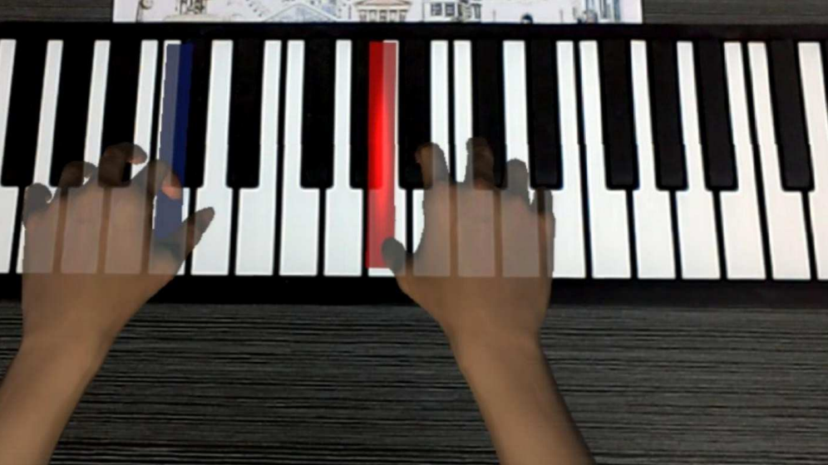
Related work
VR, AR and MR in music education and training
S. Serafin, S. Gelineck, N. Böttcher, and L. Martinussen, “Virtual reality instruments capable of changing physical dimensions in real-time,” 2005
H. H. S. Ip, K. C. K. Law, and B. Kwong, “Cyber Composer: Hand Gesture-Driven Intelligent Music Composition and Generation,” in 11th International Multimedia Modelling Conference, 2005
V. Nagpurkar, N. Pattankar, T. Nayak, A. D’Souza, and N. Henriques, “GuitarGuru: A Realtime Guitar Chords Detection System,” in 2023 International Conference on Communication System, Computing and IT Applications (CSCITA), 2023
R. Guo, J. Cui, W. Zhao, and S. Li, “AI and AR Based Interface for Piano Training,” in 2020 International Conference on Virtual Reality and Visualization (ICVRV), 2020
Notes:
There are many other cases of virtual and semi-virtual instruments and tutoring systems for teaching and practicing music.
Like guitar guru, a tutoring system for guitar players, and cyber composer, a system for composing music using only one’s hands.
Most of these solutions require dedicated hardware, which could be expensive

Slide 6

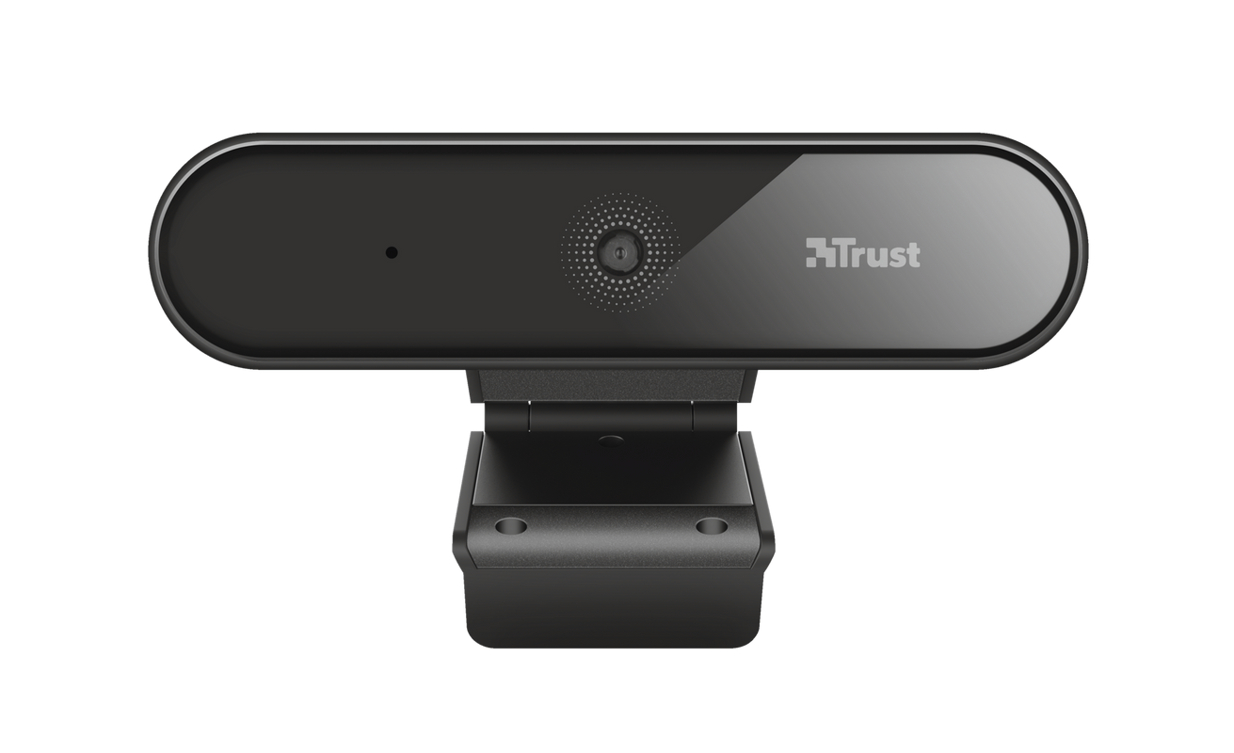
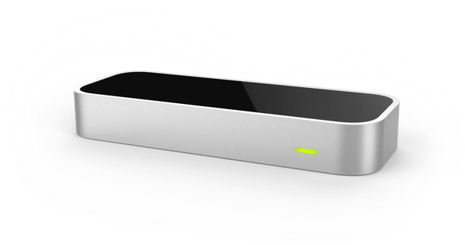
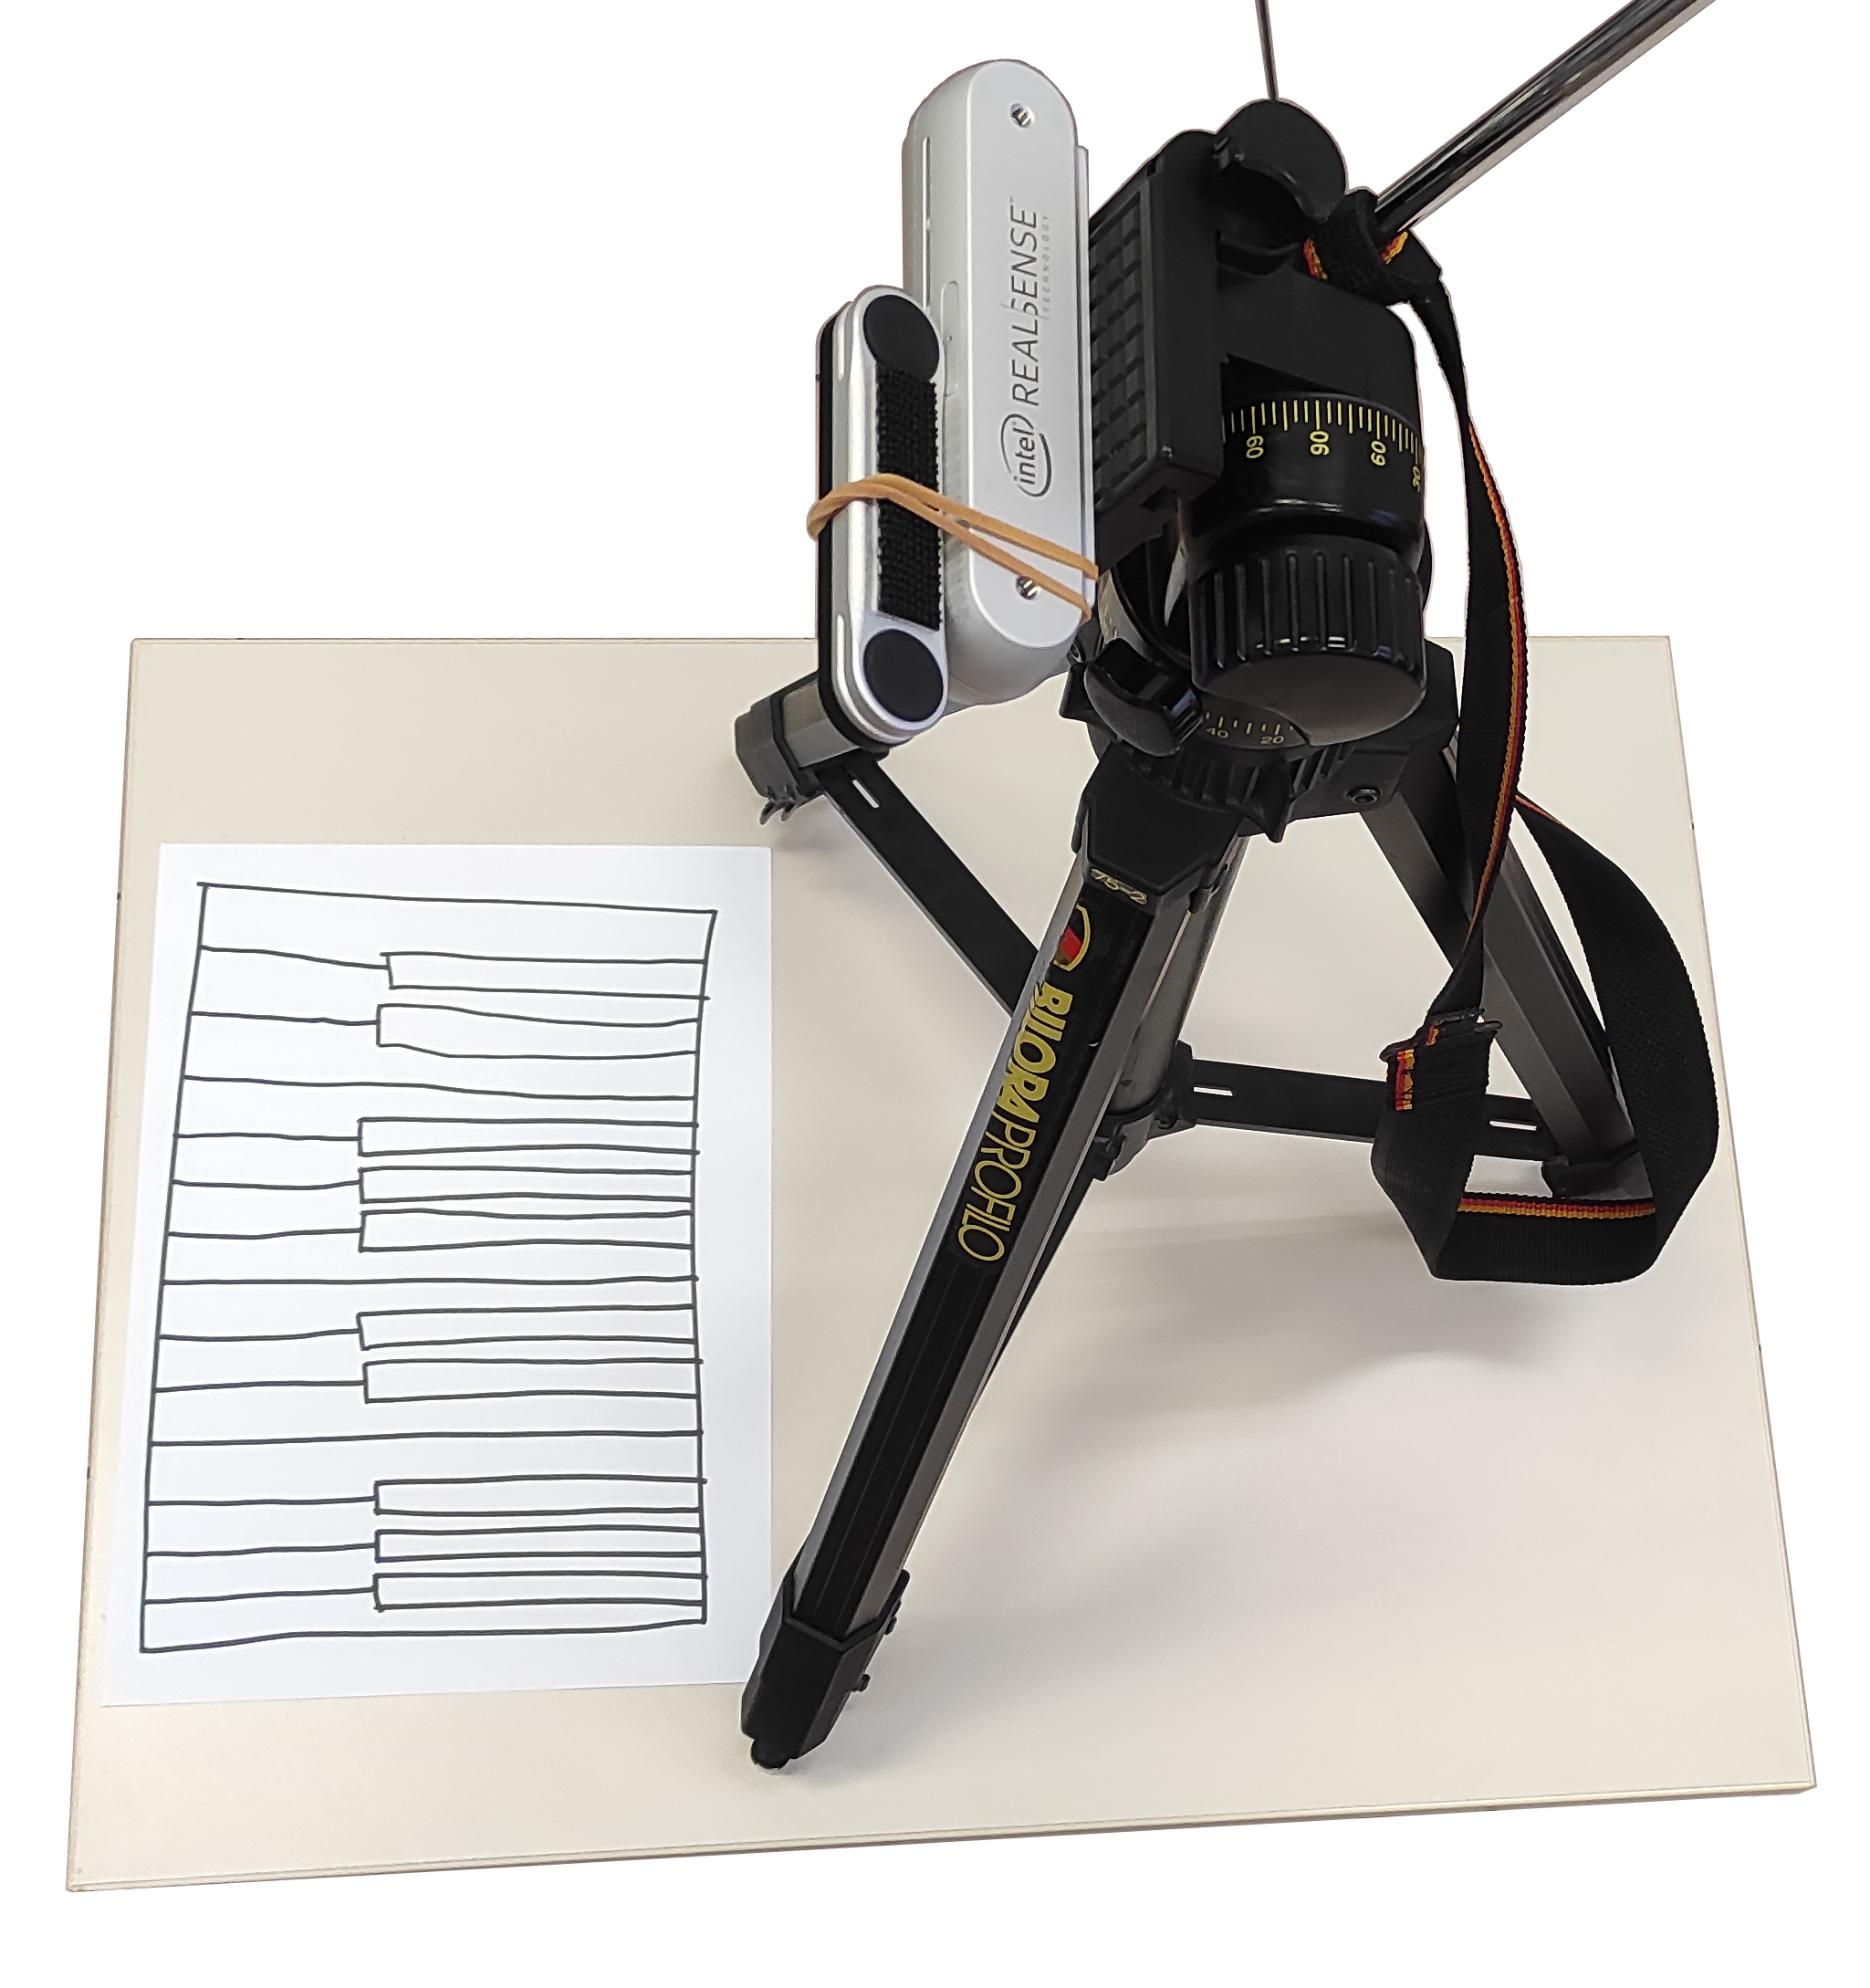

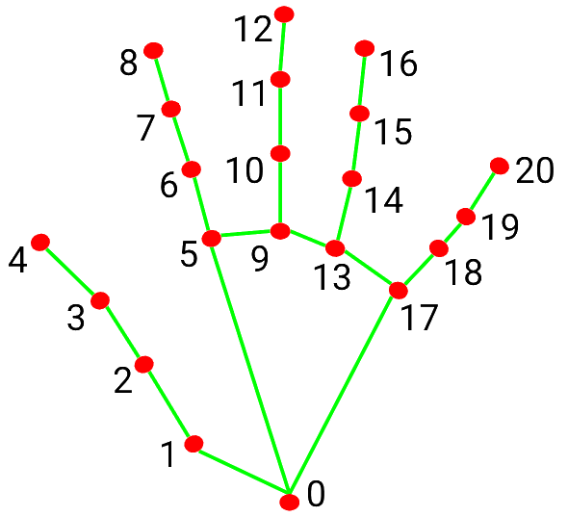
The first prototype
Webcam, LeapMotion, MediaPipe
D. Avola, L. Cinque, M. R. Marini, A. Princic, and V. Venanzi, “Keyrtual: A Lightweight Virtual Musical Keyboard Based on RGB-D and Sensors Fusion,” in Computer Analysis of Images and Patterns, 2023
Notes:
For this project we created a first prototype which consisted of three hardware components and one software component:
Webcam
LeapMotion controller
Computer
MediaPipe
LeapMotion controller is a device used to capture hands in three dimensions and is usually attached on virtual reality headsets.
MediaPipe is a software developed by google, with the feature to do hand detection from single RGB images

Slide 7
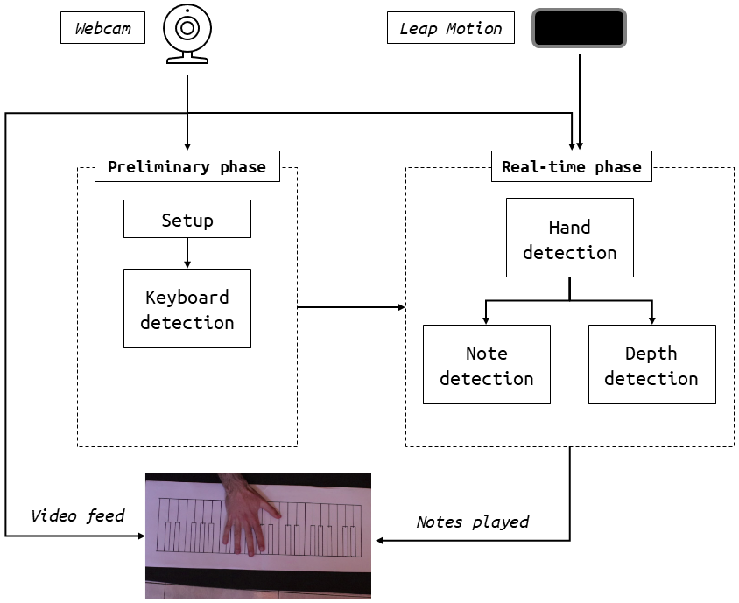
The first prototype
Architecture
Notes:
The software consists of two phases: a preliminary phase in which we do keyboard detection and a real-time phase in which we use leapmotion and mediapipe together to detect hand movements and play notes accordingly

Slide 8
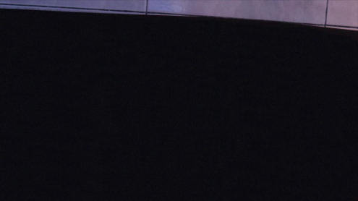
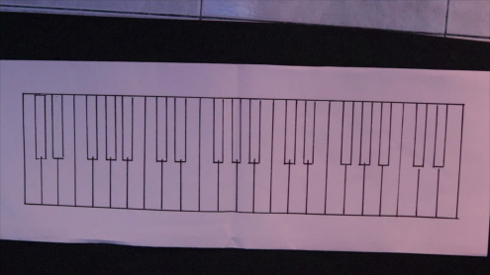
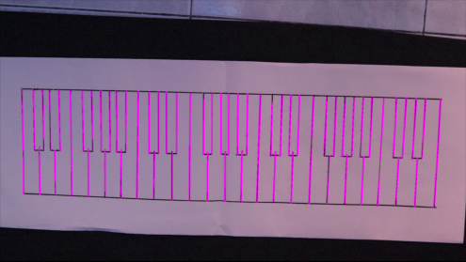
The first prototype
Keyboard detection
Background subtraction
Adaptive thresholding
Canny edge detector
Hough lines
K-means
Notes:
Keyboard detection is done with a background subtraction technique. Then we apply classical computer vision algorithms to detect straight lines and find the tiles on the piece of paper.
We use lightweight algorithms because we want the software to be compatible with low end devices

Slide 9
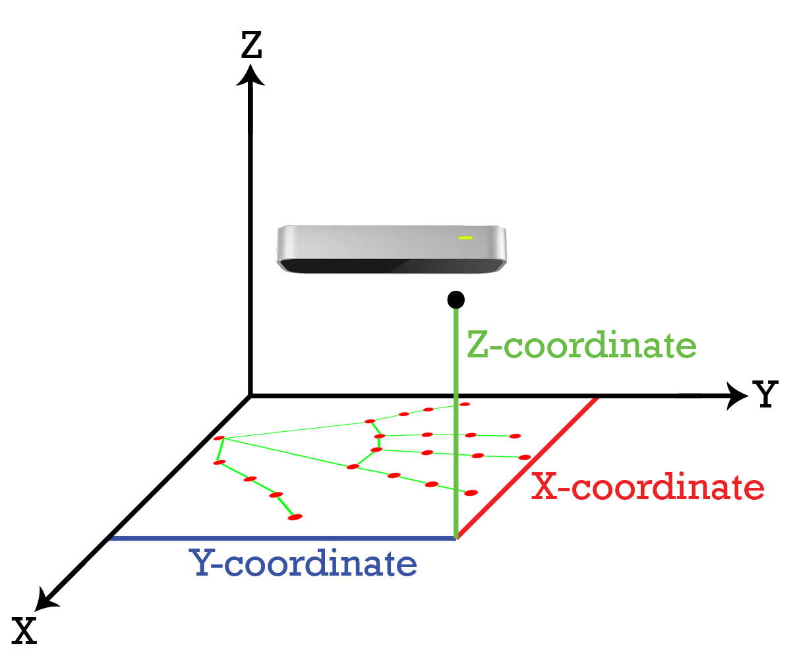
The first prototype
Hand detection
Notes:
To do hand detection we use leapmotion and mediapipe to track the hands in 3-dimensions. we use mediapipe to detect the bidimensional position of the hand and the leapmotion to detect the distance between the fingers and the table. When a finger touches the table we play the sound.

Slide 10
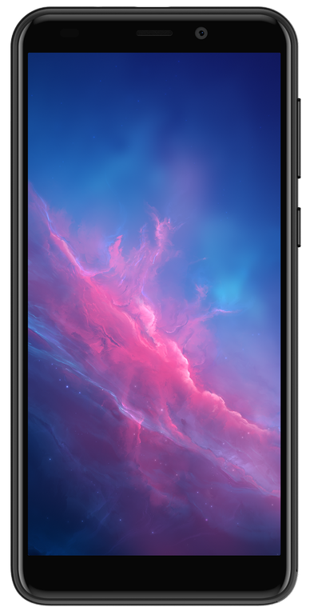
The application
All you need is a smartphone
21 October 2024
16:42
Notes:
This prototype was functional but had the problem of needing expensive and dedicated hardware to work, so we decided to port the system on a smartphone to make it accessible to everyone at zero cost.
Without the leapmotion we don’t have information about 3-dimensional position of the hands, so we had to come up with an alternative solution

Slide 11
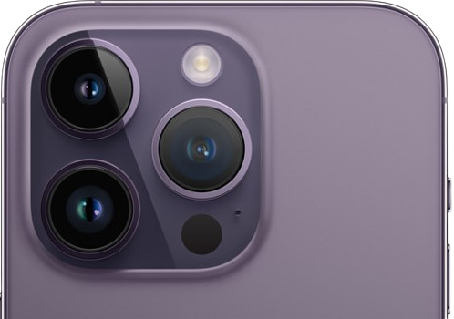
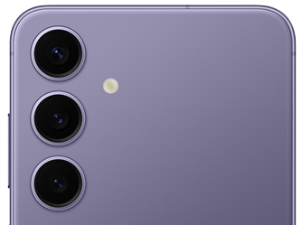
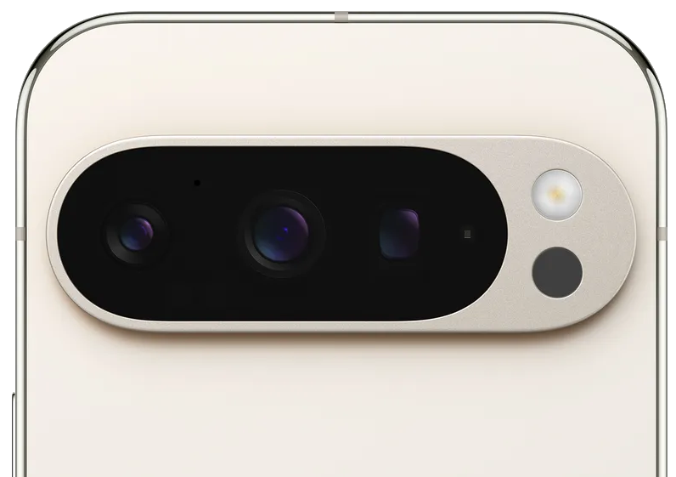
The application
Porting strategies: depth sensors and stereo vision
Notes:
Without leapmotion we don’t have 3-dimensional information anymore, so we tried different approaches to compensate with the hardware that we have on a smartphone.
We tried with depth sensors, a common hardware in many high-end devices, but they are not available on all smartphones and not precise enough for our use-case.
We also thought about using stereo vision techniques, but the availability, position and purpose of the different sensors on different models of smartphone is unpredictable and cannot be used for this purpose

Slide 12
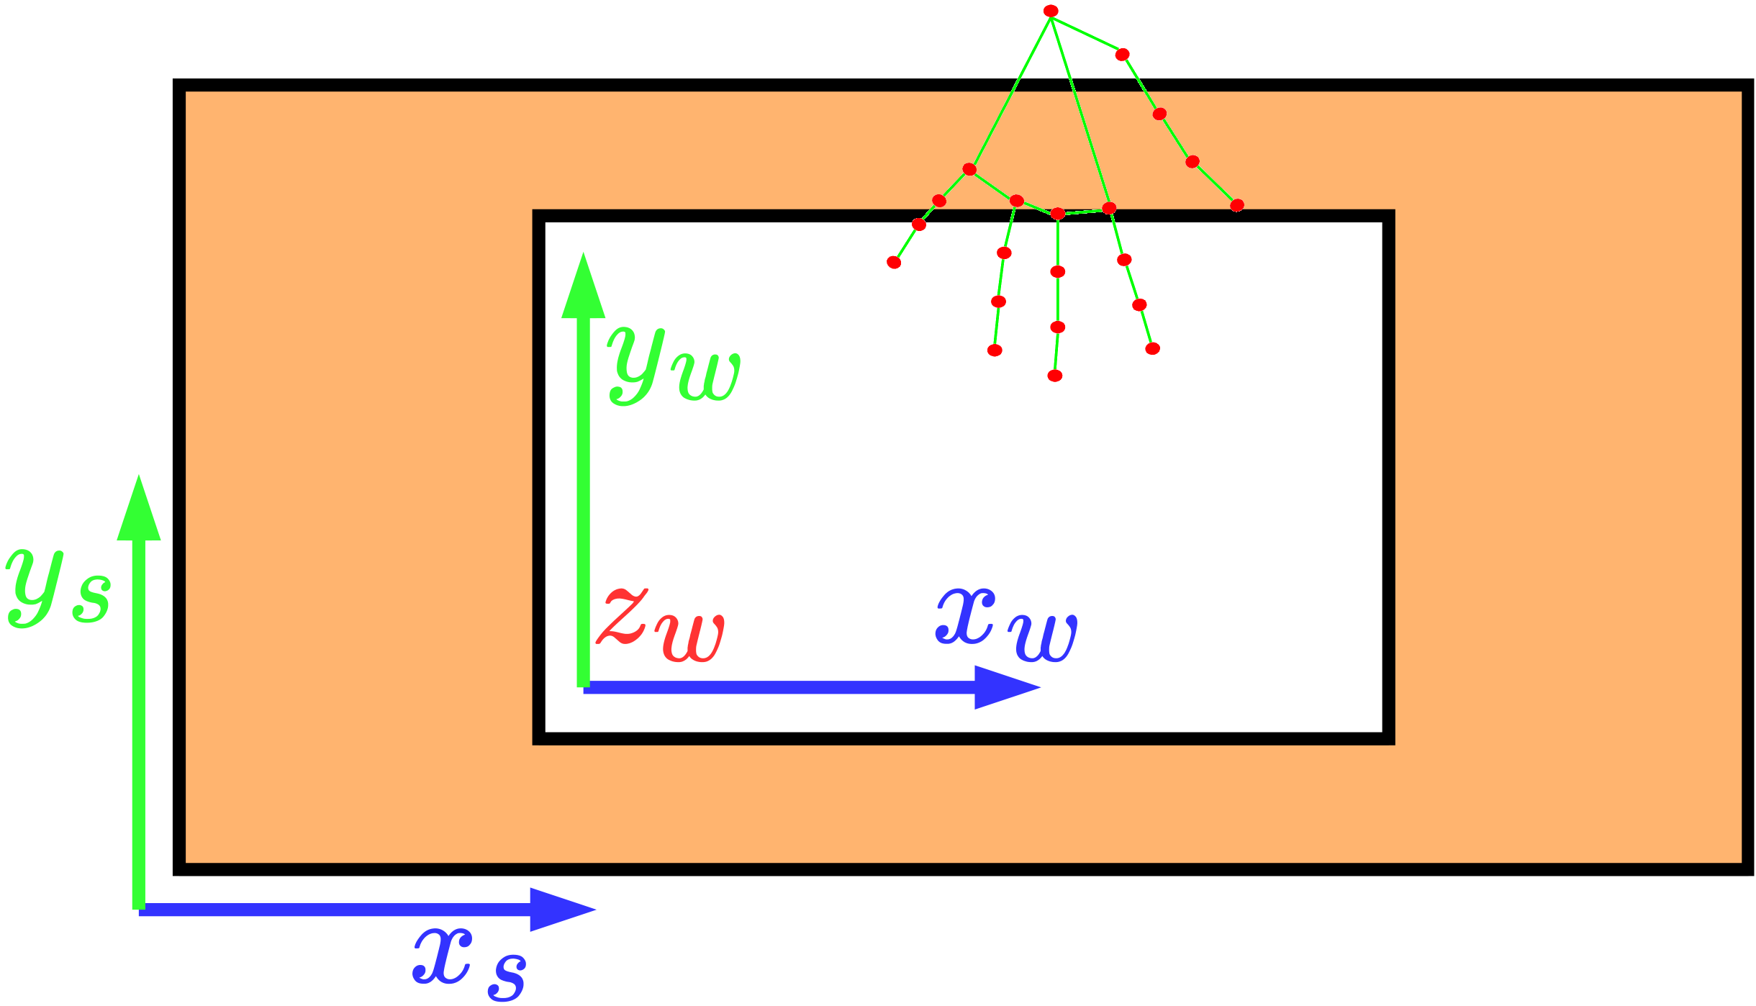
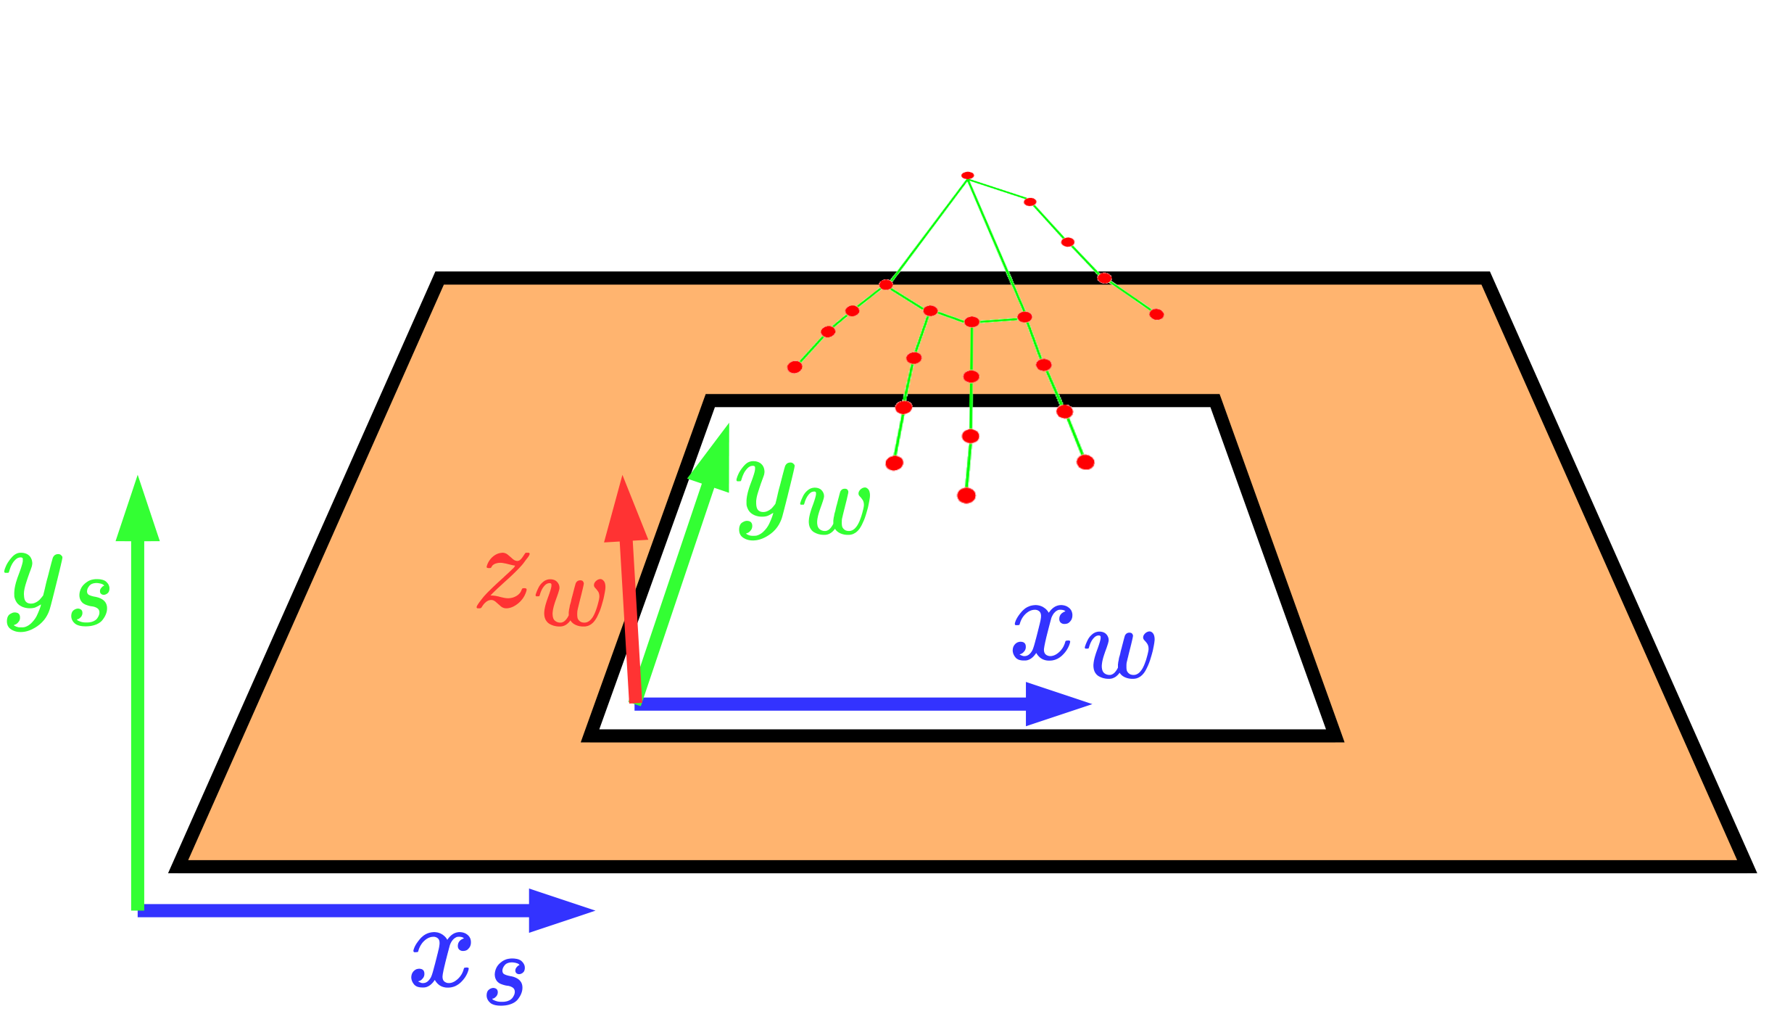
The application
Porting strategies: camera angle
90°
45°
Notes:
So, we ended up changing point of view, by lowering the camera from a 90-degree angle to around 45-degree.
This gives a partial view on the distance between fingers and the keyboard

Slide 13
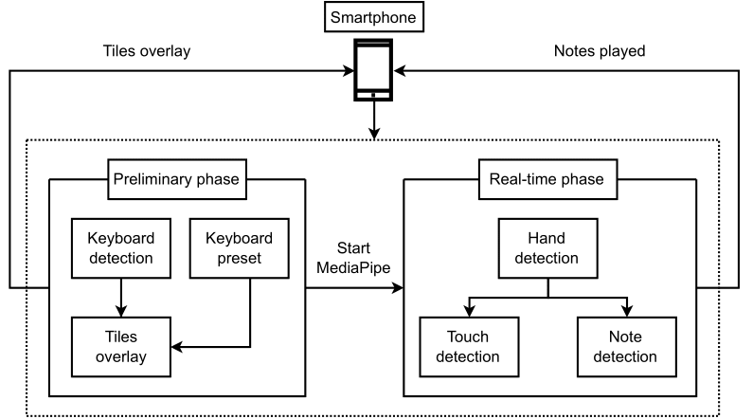
The application
Architecture
Notes:
The application still has a preliminary phase in which we do keyboard detection and a real-time phase in which the notes are played, but this time everything is simpler

Slide 14
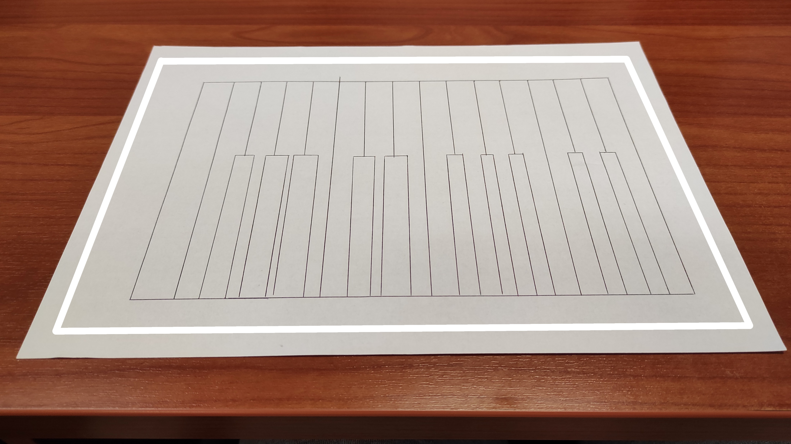
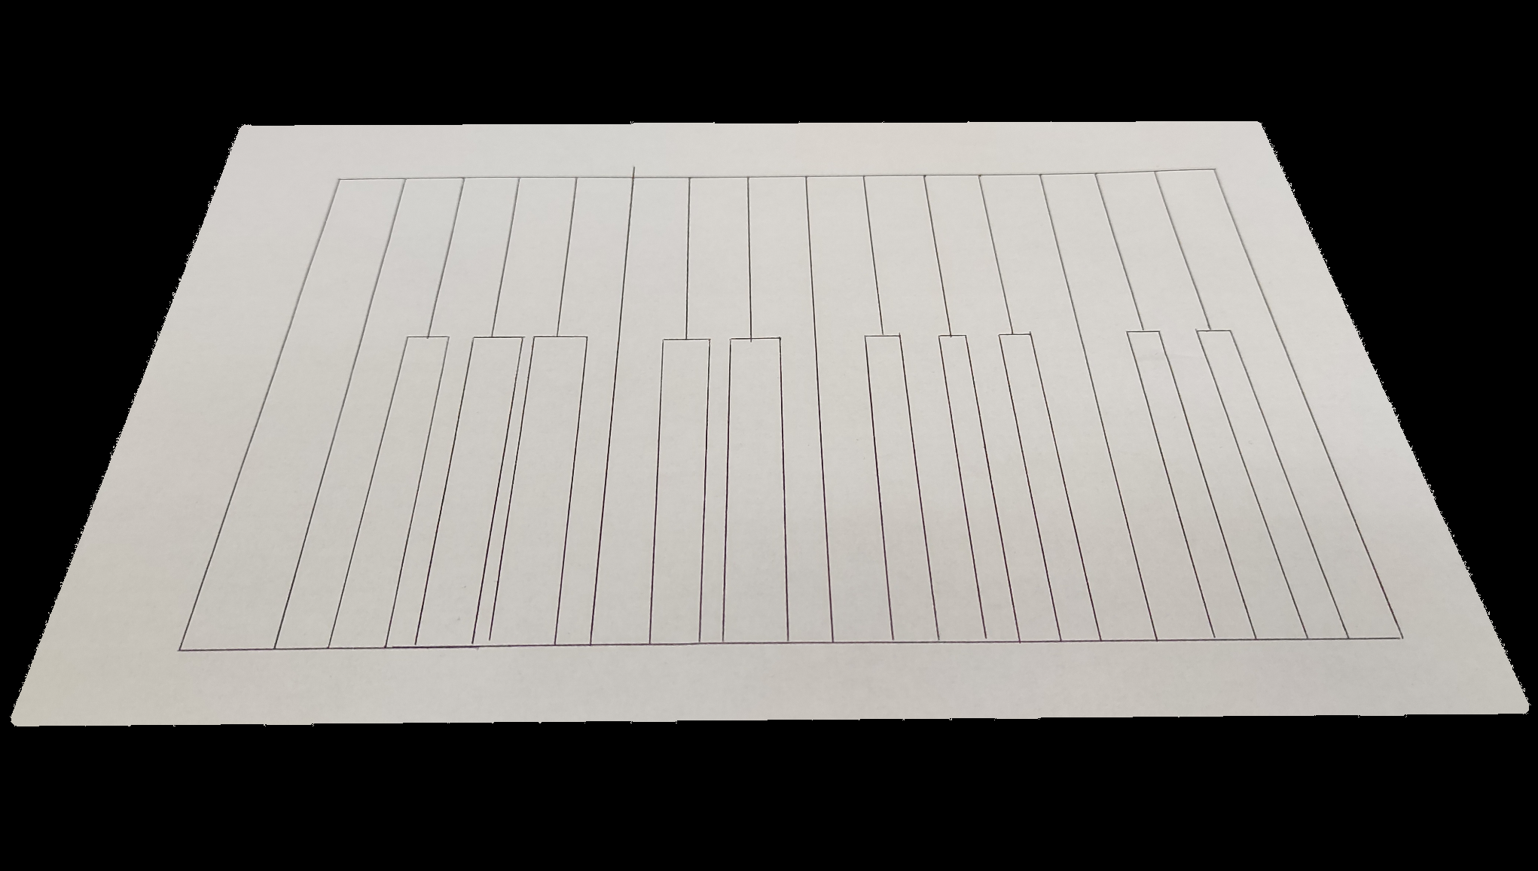
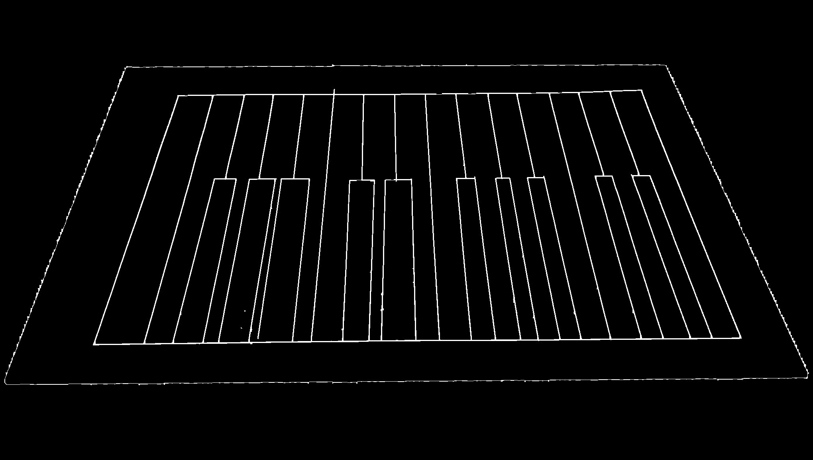



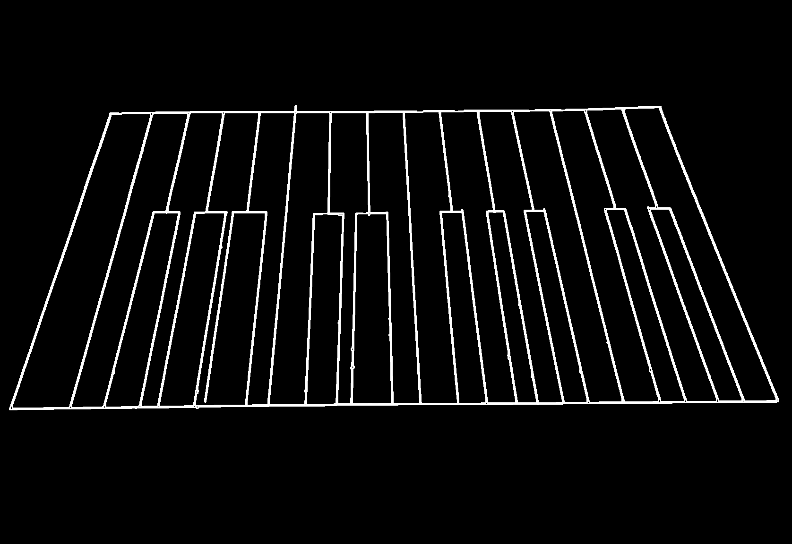
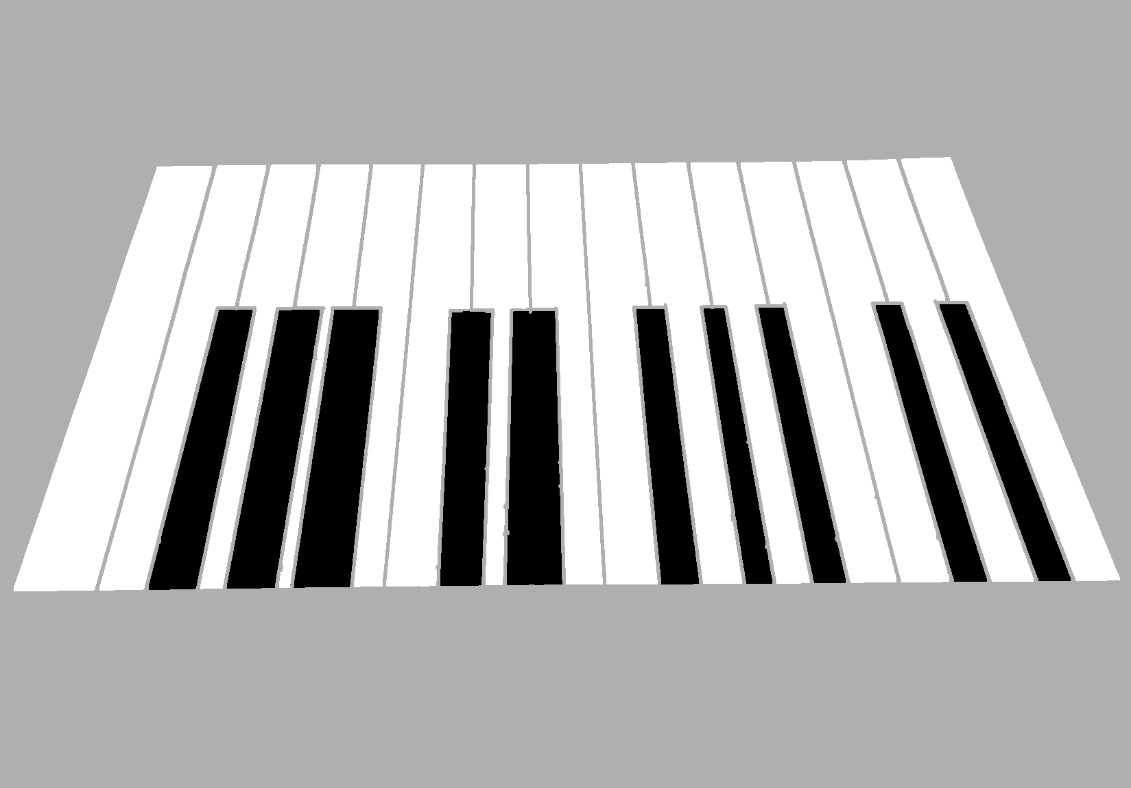
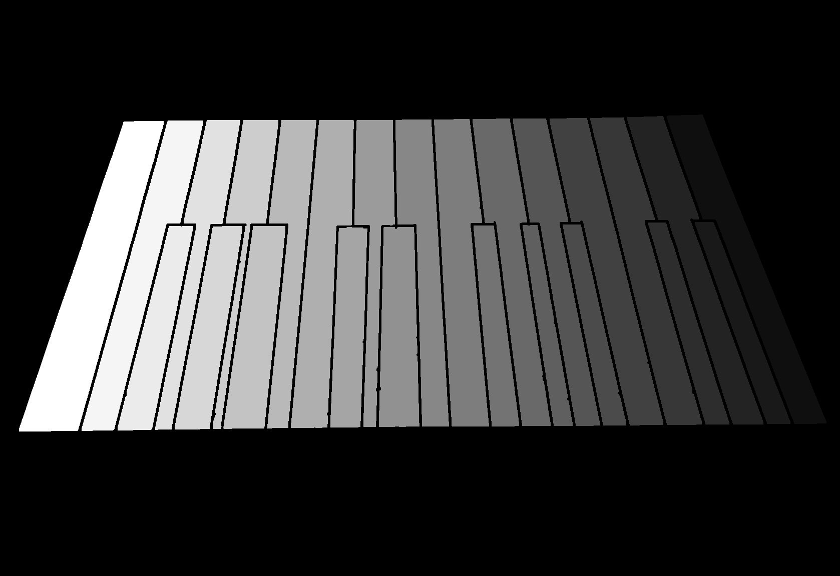


The application
Keyboard detection
Perimeter
Background subtraction
Canny edge detection
Contour detection
Tiles overlay
Notes array
Notes:
The new keyboard detection phase doesn’t need to do background subtraction anymore.
What we do is display a perimeter on the screen, so that the user frames the keyboard inside the perimeter and the detection is done only inside the area.
Then we still use classical and lightweight computer vision algorithms but now we detect contour instead of straight lines.
This is because we want to detect also hand drawn keyboard.
In the end we create two images: one is the result of tile detection and is shown to the user to give immediate feedback, and one is a grayscale image in which each tile is colored with a scale of gray, corresponding to the note that the tile plays

Slide 15
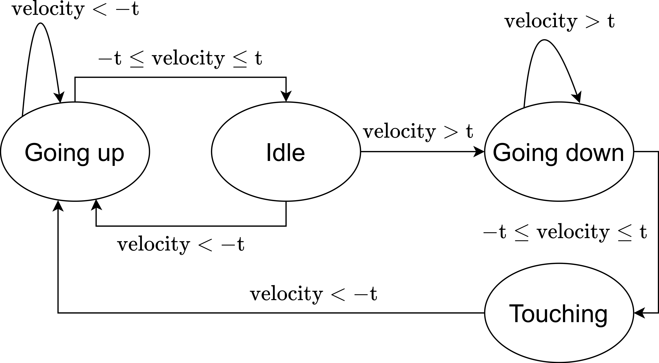
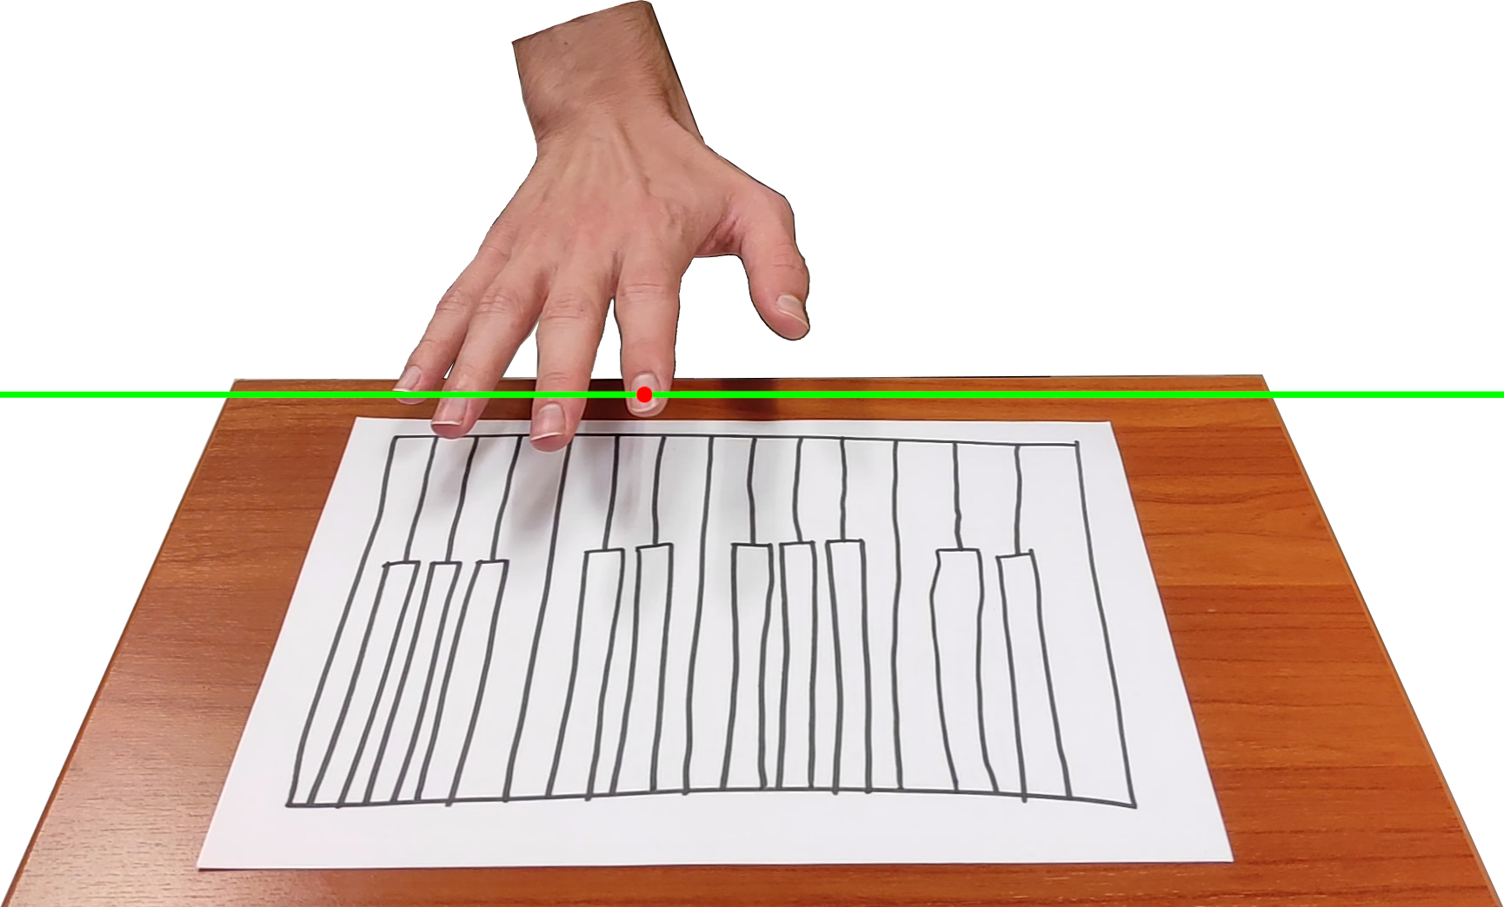

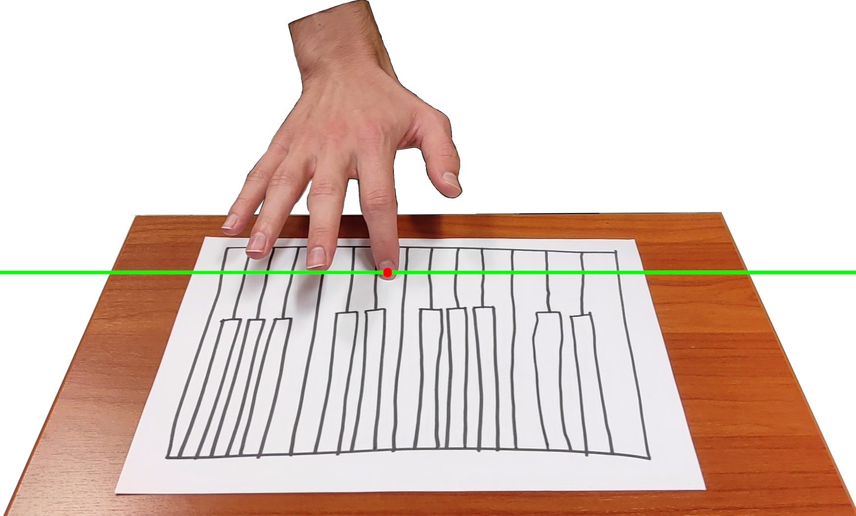
The application
Touch detection
Notes:
For detecting when a finger touches the table, we use the new point of view and a simple finite-state-automata to keep track of the finger. We monitor the up and down velocity of the finger, and the sound is triggered when the finger stops after going down

Slide 16
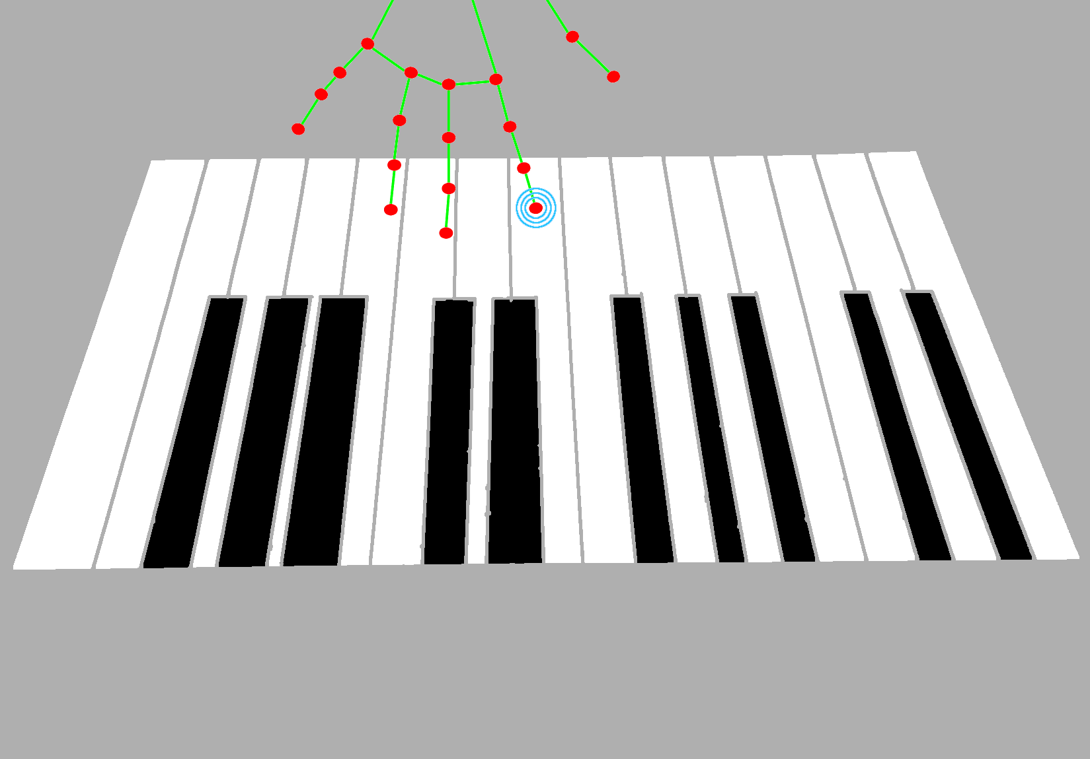
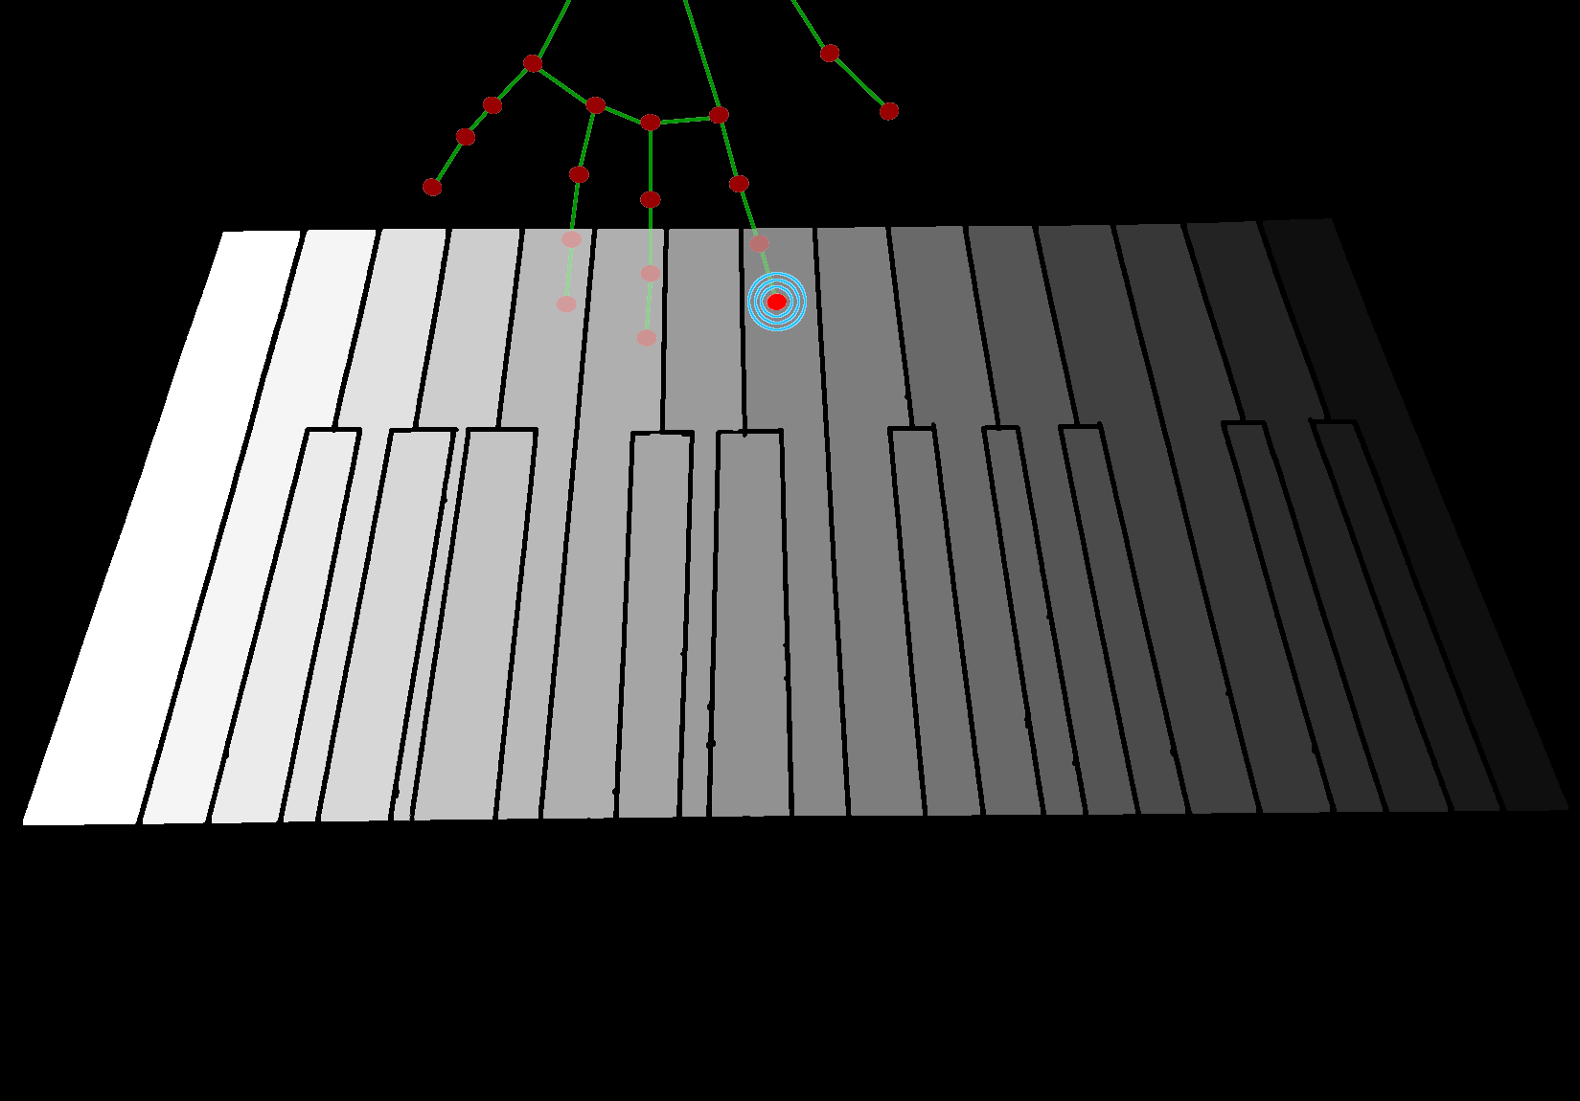

The application
Note detection
Notes:
To find which note to play we simply take the position of the finger and use it to look at the grayscale image of notes. If the pixel in that image is not black, then we look at the intensity of the pixel and that is the note to play

Slide 17
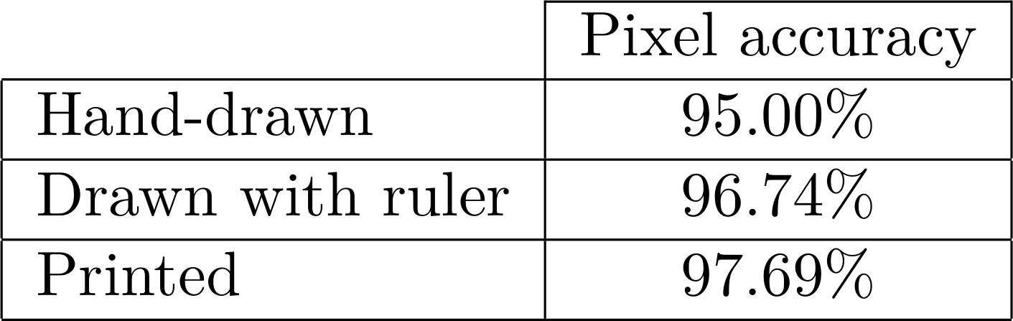
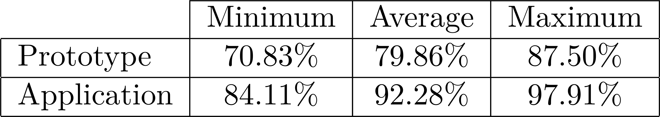
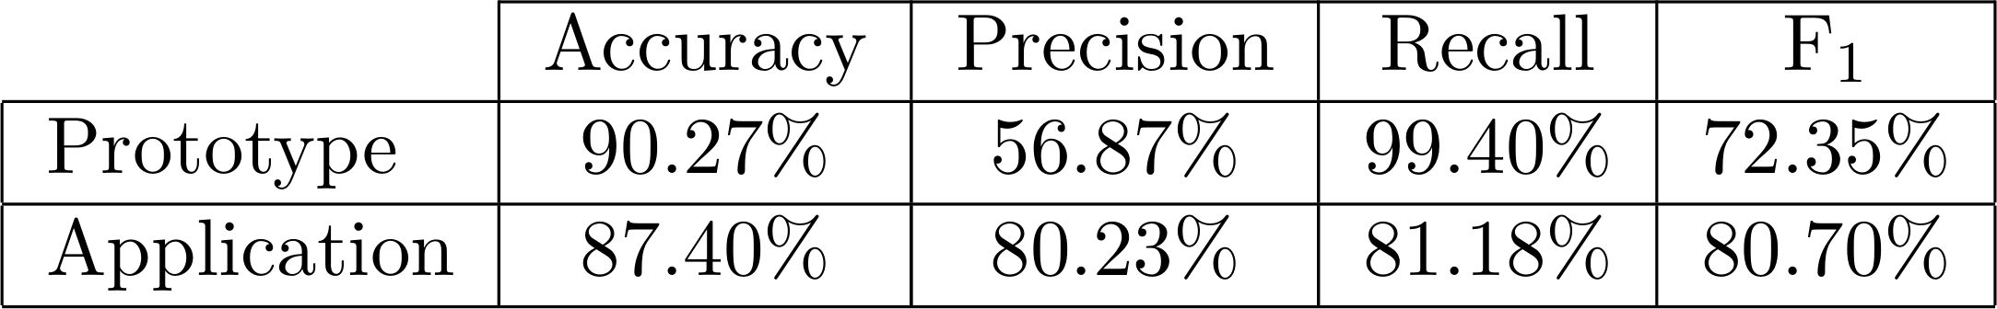
Results
Prototype vs Application
Quantitative results
Qualitative results
Keyboard detection
Usability questionnaire (UMUX)
Real-time phase
Notes:
We performed some tests and compared the prototype to the application.
As you can see, the new keyboard detection algorithm is very accurate with all possible kinds of keyboard.
The algorithm for note detection is more precise but less accurate, but in the end is still better than the old one despite the lack of leapmotion.
The usability of the system improved a lot, because the application only needs one device, and the keyboard detection phase is much simpler than before

Slide 18
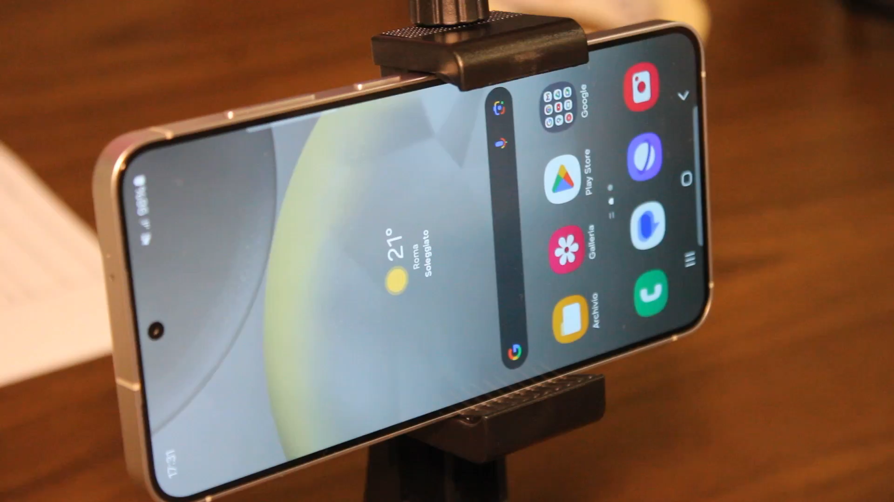
Notes:
This is a demonstration of the app

Slide 19
Thank you!

Slide 20
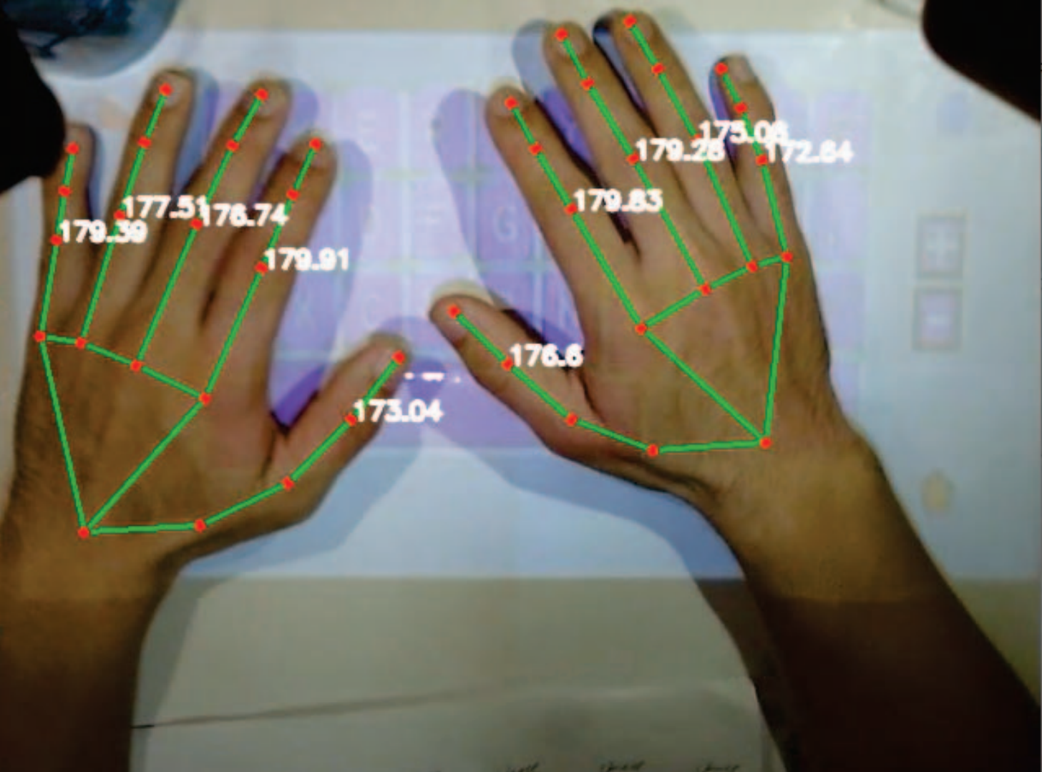
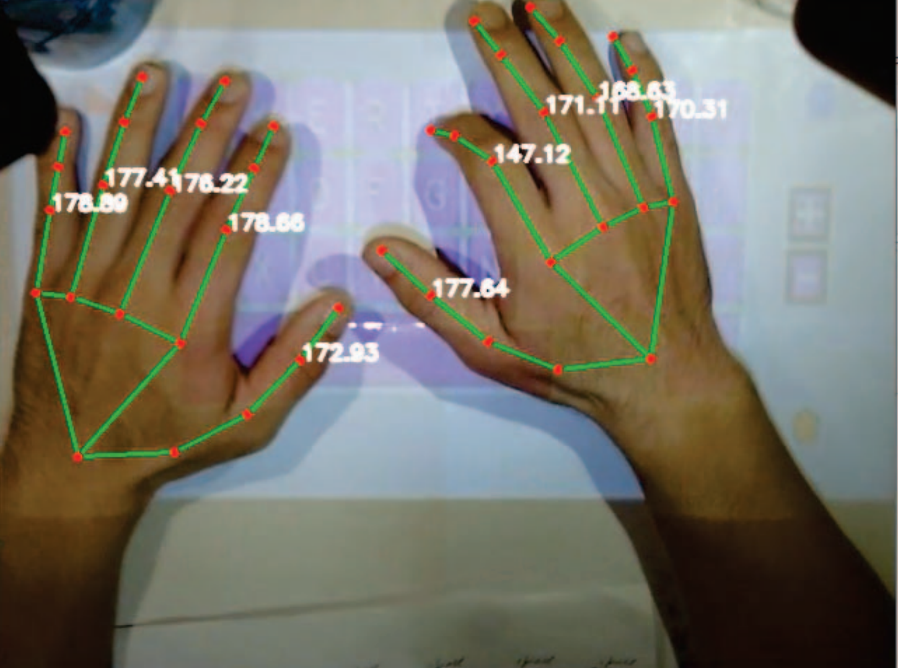
The application
Future development
D. Bisht, A. Pal, and S. Banerjea, “VKM: A Virtual Keyboard and Mouse Solution Towards a Lightweight Computing System,” in 2024 20th International Conference on Distributed Computing in Smart Systems and the Internet of Things (DCOSS-IoT), 2024
Notes:
We are developing a touch detection algorithm that uses the same techniques used in virtual typography keyboard

Slide 21
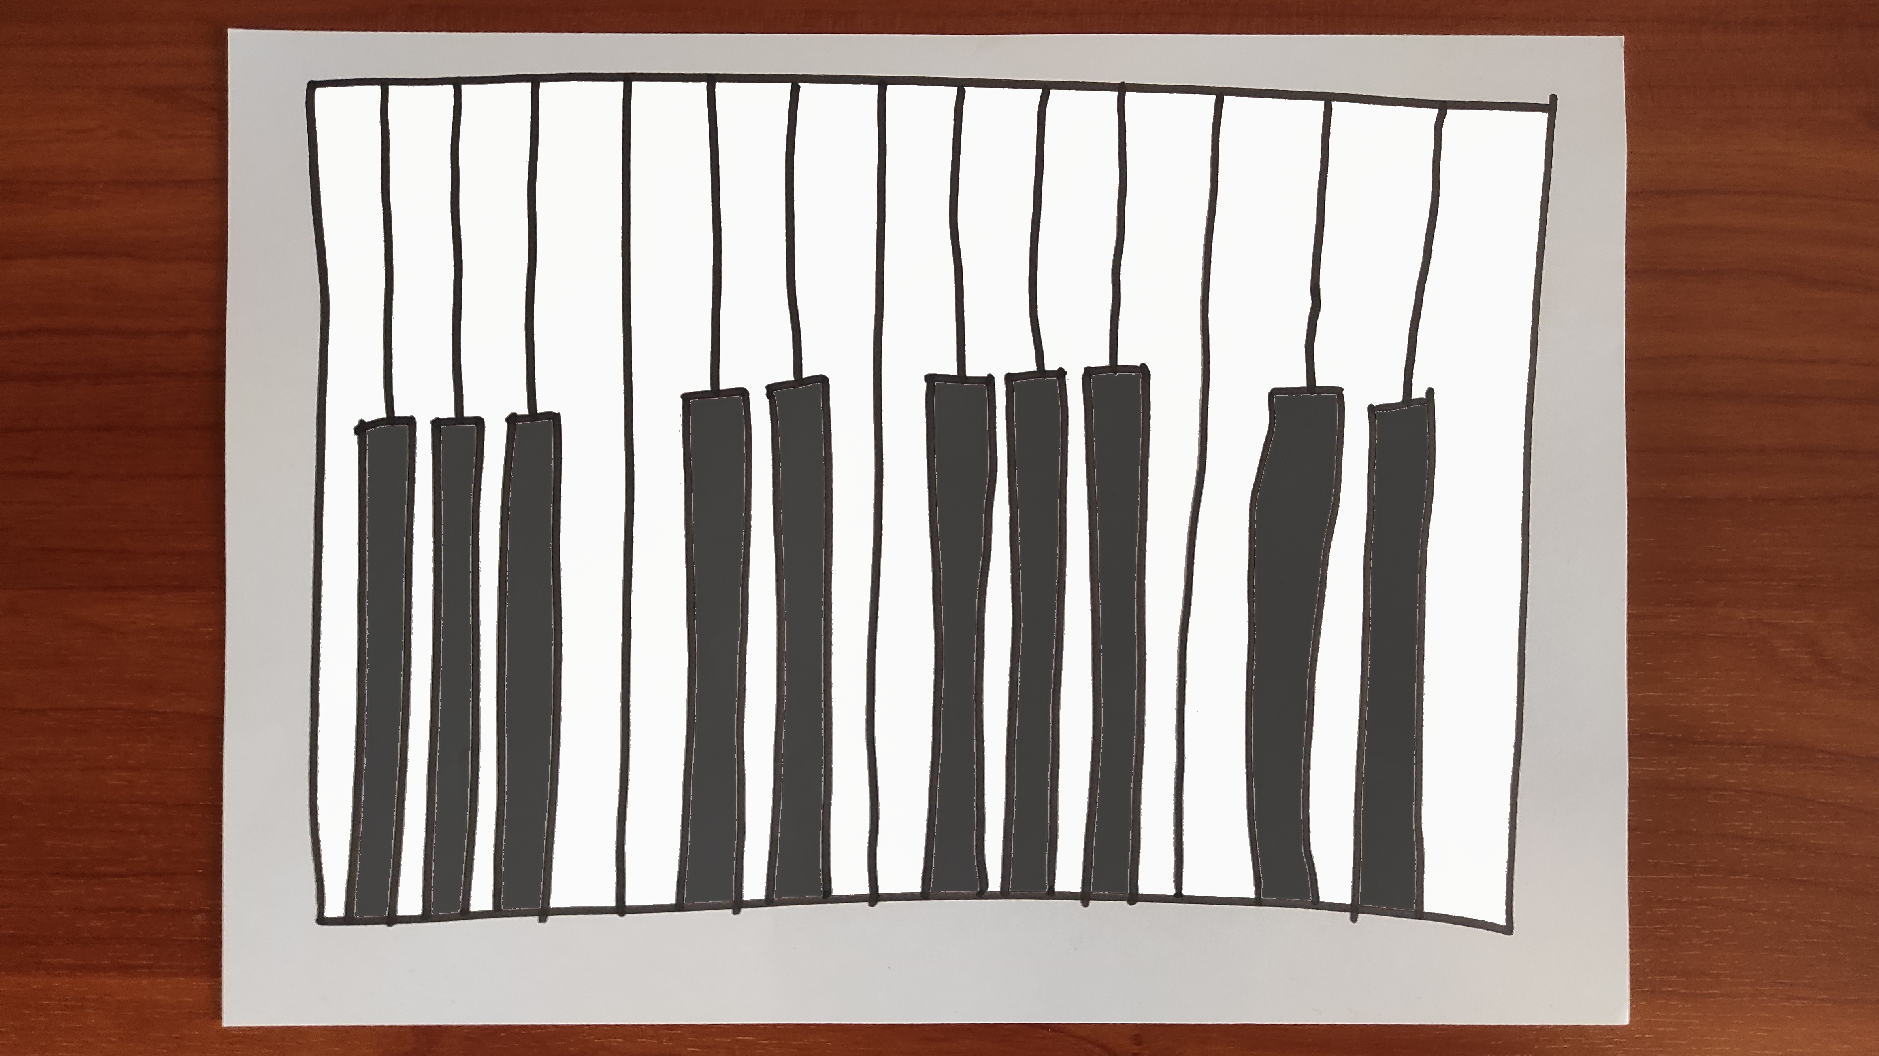
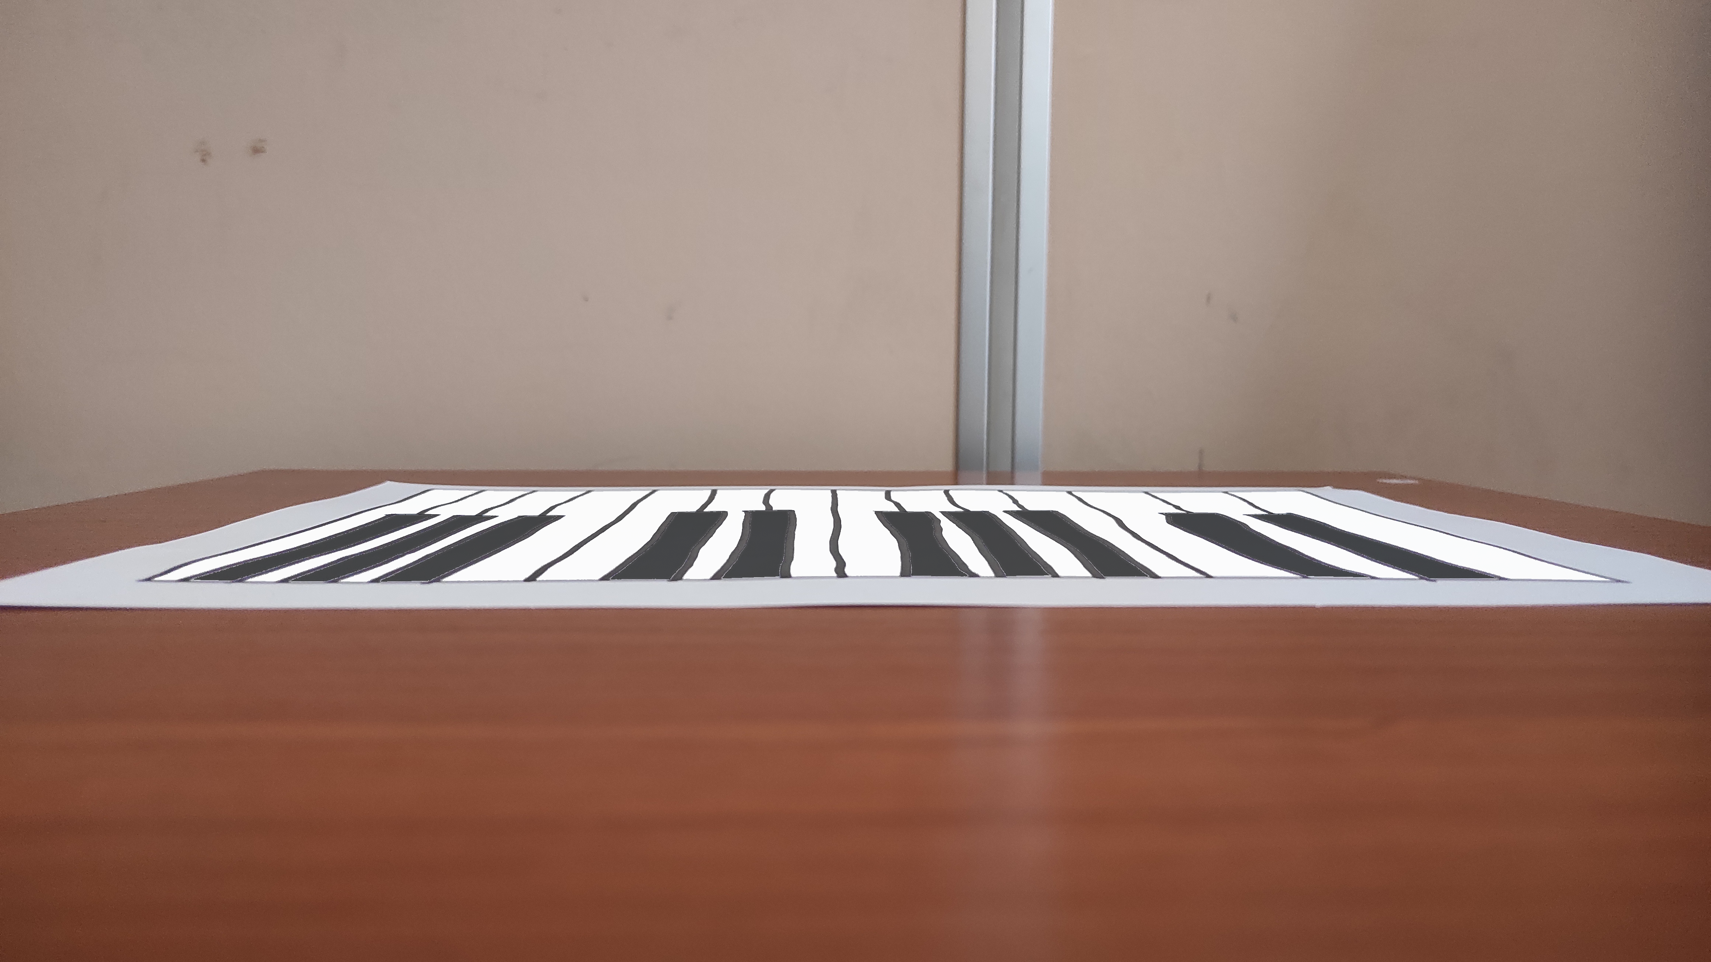
The application
Future development
Notes:
We are also thinking about changing the point of view even lower than 45-degree, by performing keyboard detection first from above and then switching to a lower position, transposing the detected keyboard on the new plane

